Slide 1
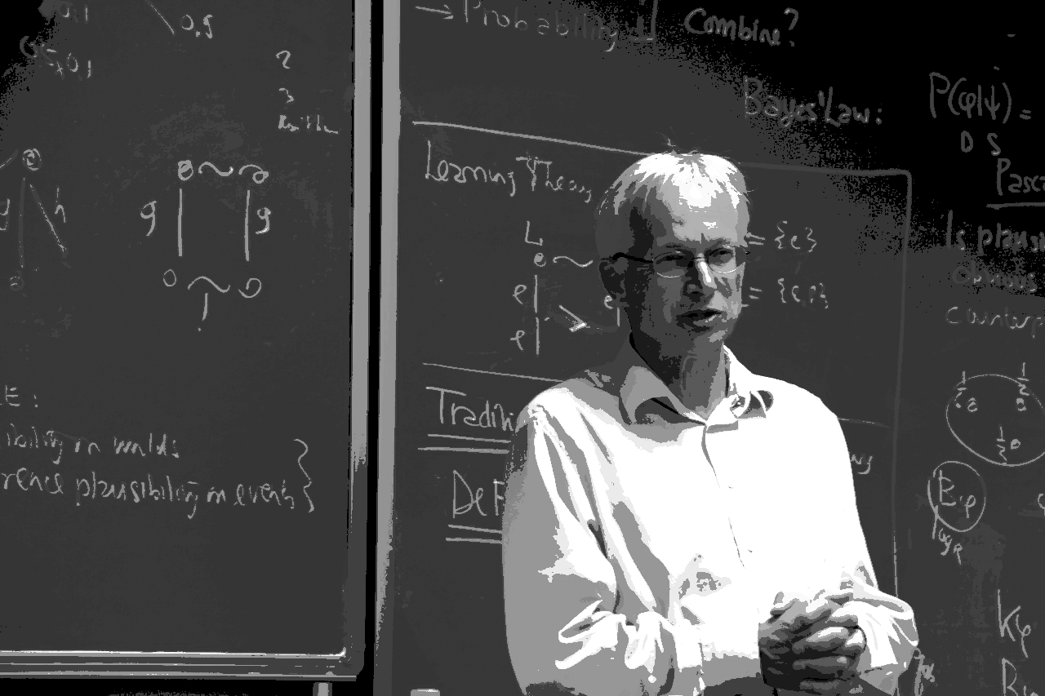
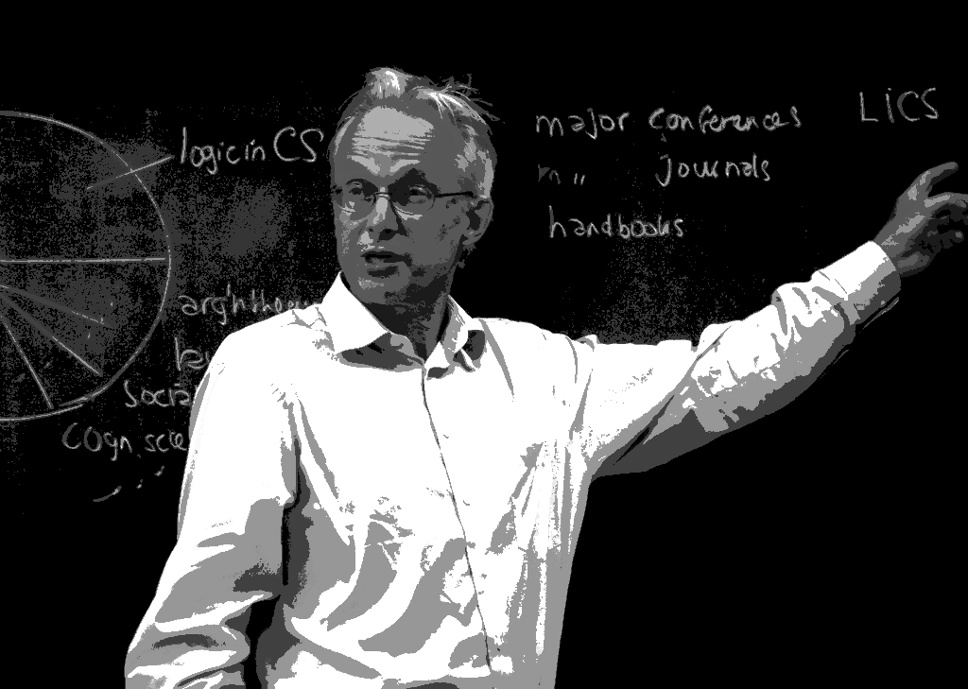
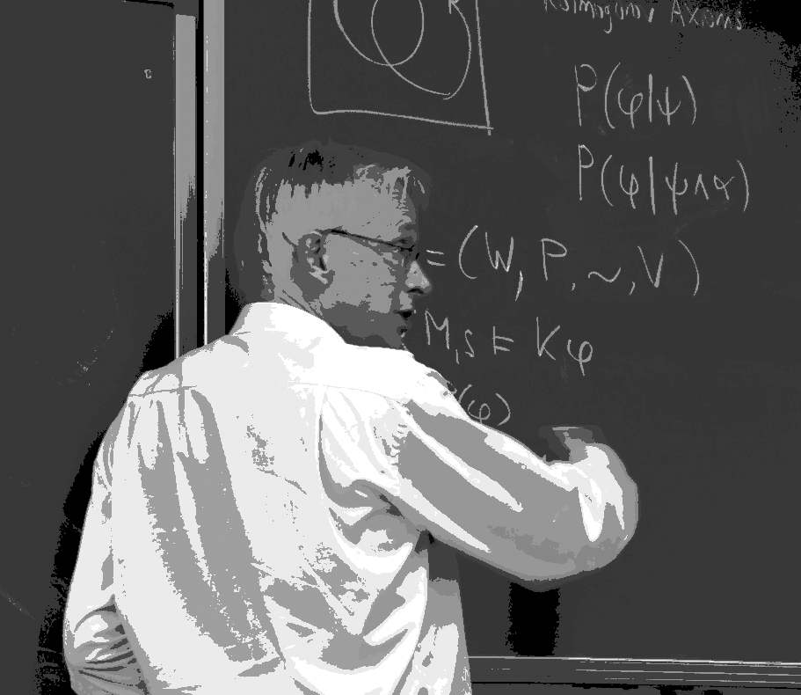
THIS IS HOW WE DO IT!
Logic and Information van Benthem-style
Celebration Event in Honor of Johan van Benthem
Amsterdam, September 26-27, 2014
Vincent F. Hendricks
Professor of Formal Philosophy
University of Copenhagen
Denmark

Slide 2
THE STUDY OF VALID INFERENCES
LOGIC
THE STUDY OF INFORMATION PROCESSING

Slide 3
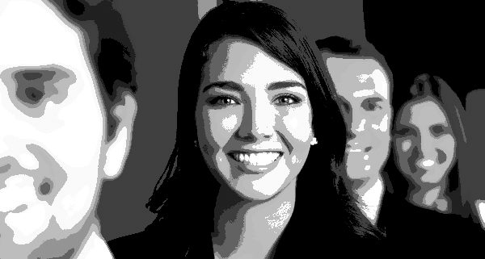
Believing
Knowing
Thinking
Inquiring
Arguing
Learning
Deliberating
Expanding
Exchanging
Retracting
Contracting
Revising
Acting
Interacting
Reacting
Playing
Winning
Planning
Predicting
Preferring
Voting
Extrapolating
Understanding
Explaining
…
HUMAN HAPPENING
AGENCY
individual and/or collective

Slide 5
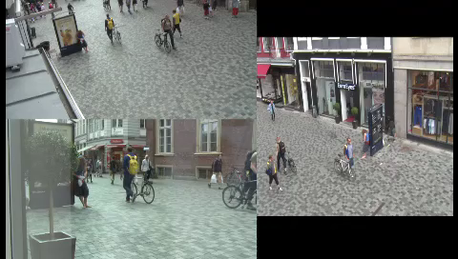
Stand by … bystander

Slide 6
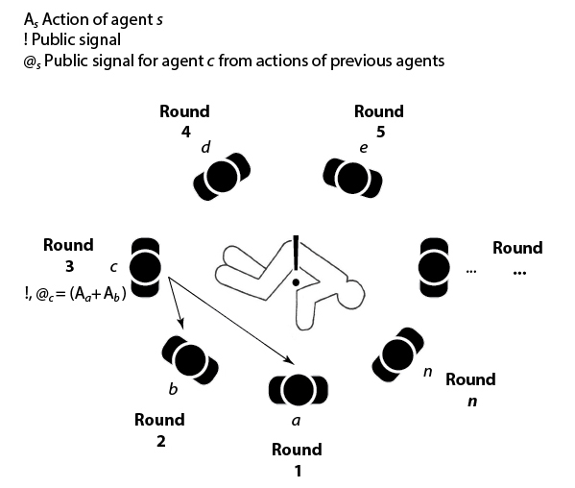
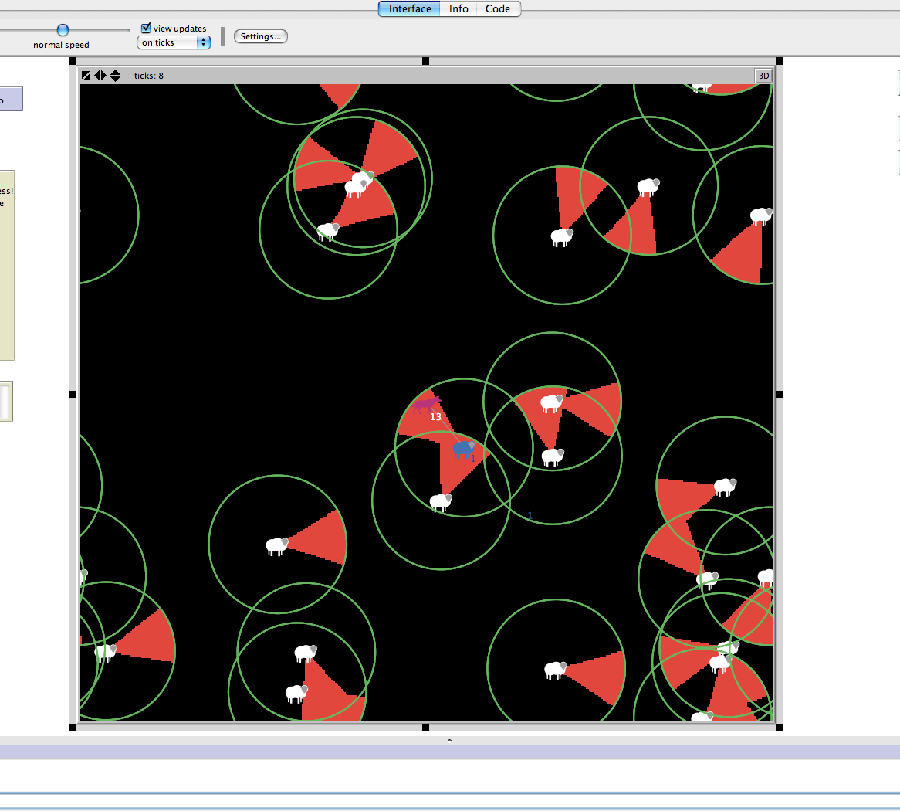
Bystander effect
Model
Simulation

Slide 7
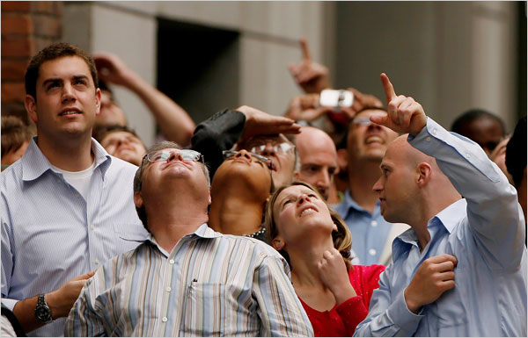
SOCIAL PROOF
Single agents assume beliefs / norms / actions of other agents in an attempt to reflect the correct view / stance / behavior for a given situation

Slide 8
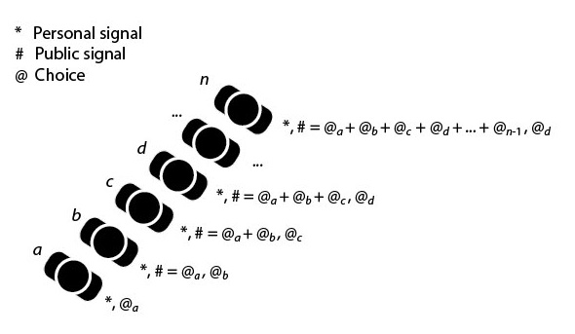
Informational cascade
Model
Logical structure
The logical structure behind a cascade includes (Hansen, Hendricks, Rendsvig 2013):
A set of rational agents that act sequentially
A set of options between which the agents can choose
A preference order on the outcome of each choice

Slide 9

BUBBLES
Bubbles generally refer to unfortunate (irrational) collective ways of aggregating
behavior
beliefs
opinions
preferences
based on social proof (in science and society at large)

Slide 10
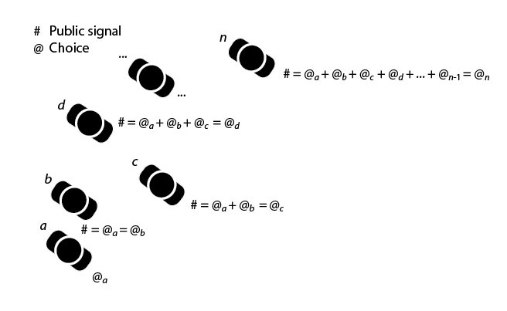
Bandwagon effect
Model
Model run
A run of such a model may be conceived as a crowd of agents, each waiting to make a decision between a (finite) set of choices
Before receiving the public signal of left or right, each agent will be indifferent between the two options
The first agent decides, say left (possibly at random or based on a private signal) thereby conveying a left action to all subsequent agents

Slide 11
Bystander – Bandwagon – Cascade
Models
Modules
Agents
Beliefs
Network Topology
Signals
Actions
Preferences
Decision rules
Interpretation rules

Slide 12
Cloud of confusing concepts

Slide 13
Bystander – Bandwagon – Cascade
 | Agents | Network topology | Public signal | Private signal | Actions | Decision rules | Int. rules | Pref.
Bystander | Yes | Circular | Yes | No | 3 | Yes | Yes | Yes
Bandwagon | Yes | Crowd | Yes | No | 2 | Yes | Yes | Yes
Cascade | Yes | Linear | Yes | Yes | 2 | Yes | Yes | Yes

Slide 14

LOGIC
STRUCTURE

Slide 15
Philosophy
Mathematics
Computer Science
Linguistics
Economics
Cognitive Psychology
Social Psychology
Social Science
Sociology
Behavioral Science
Software Engineering
…
Defined the paradigm
- ambition
- agenda
- tools
- seminal results
- exemplars
- environment
- infrastructure
-integration
-cooperation
…
THANK YOU

