Slide 1
Georgian Language Extended Representation with Semantic Networks and Processing Using the Wave Principle
Liana Lortkipanidze, Natela Archvadze, Merab Pkhovelishvili
Tbilisi State University & Georgian Technical University
Notes:
Welcome. Today I will present our work on extended representation of the Georgian language using semantic networks and a wave-based processing model.

Slide 2
Research Motivation
Natural Language Processing (NLP) is essential in the digital age.
The Georgian language poses specific challenges that require custom solutions.
Notes:
“Developing software tools for the Georgian language is beneficial for both academic and practical applications.”
With the advancement of information technology, natural language processing (NLP) has become an increasingly important field. NLP encompasses various methods and algorithms for the automatic analysis and generation of text and speech. Due to its unique linguistic features, the Georgian language presents particular challenges for computational processing. However, significant progress has been made in recent years.
Developing software tools for the Georgian language is beneficial for both academic and practical applications. Key areas include text processing (including syntactic and morphological analysis), speech recognition and generation (crucial for voice assistants and translation systems), automatic translation and annotation of Georgian texts, and, finally, the preservation and promotion of the Georgian language online.
Georgian, as a morphologically rich language, requires tailored solutions.

Slide 3
Introduction
The Georgian language's rich morphology complicates NLP.
Traditional pipelines separate morphology, syntax, and semantics.
We bypass syntax by using semantic networks directly.
Notes:
Traditional NLP pipelines separate morphology, syntax, and semantics. In our approach, we skip syntax and model context directly within semantic networks., we justify bypassing syntactic analysis by handling context-dependent languages directly within semantic networks.

Slide 4
Morphological Analysis
Morphology is the foundation of Georgian NLP.
Our system uses letter-based subnetworks for root-level parsing.
Notes:
“Morphological analysis is essential for researchers working on the computational processing of the Georgian language.” We used a tree-based data structure to represent the lexicon of the Georgian language. For morphological analysis, we created 33 networks corresponding to the 33 letters of the Georgian alphabet. When constructing semantic networks, we anticipate having as many extended networks as there are words in the language. Currently, the estimated number of actively used words in Georgian, including dialects and technical terms, is around 200,000. Our system enables morphological analysis of any root form within the language structure.

Slide 5
Semantic Networks
We build on Woods' classic model, integrating transitions between subnetworks for complex term handling.
We refer to such networks as MEN
(My Extended Network).
Notes:
Semantic networks represent knowledge via nodes and relationships.
For the representation of knowledge using semantic networks, Woods introduced an additional feature—allowing transitions from any vertex in the network to another network. An extended semantic network (ESN) represents nodes and relationships in a graph structure, capturing objects and their interconnections.
Unlike traditional hierarchical models, ESNs allow bidirectional navigation between nodes. We refer to such networks as MEN (My Extended Network).
We adapt Woods' model by introducing transitions between subnetworks. MEN networks enable bidirectional traversal, including bottom-up navigation.

Slide 6
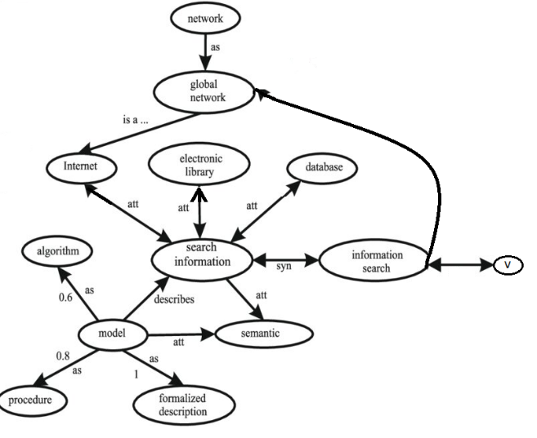
MEN-Type Network with Transition to Subnet
Notes:
This figure depicts a semantic network, where each arc represents a concept (e.g., “information search,” “model,” “semantic”). The links between them represent different semantic relationships. The vertex marked with a “V” shows the transition point to a separate subnetwork, which is the main concept of MEN.

Slide 7
MEN Network Concept
Each word can be its own network.
Subnets can process independently and support parallel computing.
Notes:
In MEN, each word is its own network. This allows transitions between words and deeper semantic analysis.

Slide 8
Wave Search Algorithm
The wave algorithm enables efficient search in MEN networks.
It traverses child nodes layer by layer, ensuring no node is visited more than once.
Notes:
The wave principle allows efficient parallel search. Each wave explores one level, avoiding repeated visits to the same node.
It operates as follows:
The search begins from a marked node.
If the target value matches the node value, the search succeeds; otherwise, the process continues in parallel on the first wave of child nodes.
If the target is still not found, the search propagates to the second wave (children of child nodes), continuing recursively.
The process ends upon locating the target node or reaching terminal nodes.

Slide 9
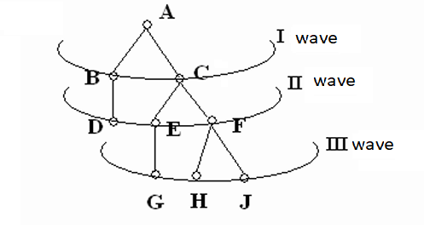
Wave Principle in Semantic Networks
Notes:
This diagram shows the core logic of the Wave Search Algorithm. Node A is the starting point; nodes B and C form the first wave, D–F the second, and G–J the third. Each wave represents one level of expansion in the search. The method ensures each node is visited only once.

Slide 10
Wave Levels & Limitations
Each wave represents a depth level.
Level control and marking are critical to avoid infinite loops.
Notes:
To prevent infinite loops, the number of waves must be limited. Nodes are marked once visited

Slide 11
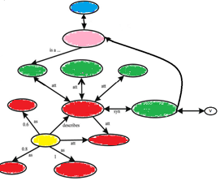
Wave Propagation in the MEN Extended Network

Slide 12
Parallel Processing with MEN
Subnets allow separate processing in multiprocessor systems.
Useful in morphology, translation, and semantic tasks.
Notes:
“Subnet processing is independent and highly efficient in multiprocessor systems.”

Slide 13
Results and Contribution
MEN and the wave principle improve performance of semantic analysis and text retrieval systems.
Notes:
“The discussed methods enable faster and more effective data processing.”

Slide 14
Conclusion
MEN networks represent a future-proof model for Georgian NLP.
They ensure adaptability and scalability.
Notes:
“Network structures are vital for modern information retrieval systems.”

Slide 15
Future Work
We aim to extend MEN applications to more Georgian dialects and integrate neural methods.
Notes:
“The methods will enhance digital presence of the Georgian language.”

Slide 16
Thank you for your attention!
We welcome your questions

