Slide 1
Using the Map of Elections
Piotr Faliszewski

Slide 2
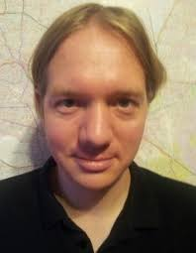
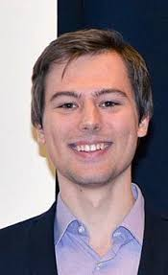
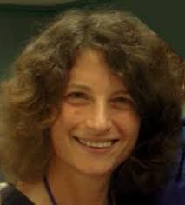



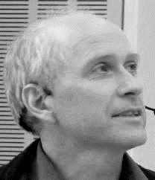


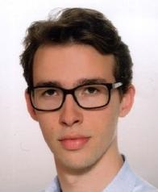



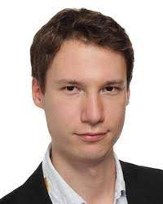
Using the Map of Elections
Piotr Faliszewski
Robert Bredereck
TU Clausthal
Germany
Niclas Boehmer
TU Berlin
Germany
Jin-Yi Cai
Univ. of Wisconsin Madison, USA
Edith Elkind
University of Oxford
United Kingdom
Austen Z. Fan
Univ. of Wisconsin Madison, USA
Piotr Faliszewski
AGH University
Poland
Łukasz Janeczko
AGH University
Poland
Rolf Niedermeier
TU Berlin
Germany
Andrzej Kaczmar-
czyk, AGH Univ.
Poland
Piotr Skowron
University of
Warsaw, Poland
Stanisław Szufa
Jagiellonian Univ.
Kraków, Poland
Arkadii Slinko
Univ. of Auckland
New Zealand
Krzysztof Sornat
AGH University
Poland & Switzerland
Nimrod Talmon
Ben-Gurion Univ.,
Be’er Sheva, Israel
Tomasz Wąs
Penn State
USA

Slide 3



An Election
v₁: > >
v₂: > >
v₃: > >
v₄: > >
E = (C,V)
C = { , , }
V = (v₁, v₂, v₃)

Slide 4
Largely studied theoretically
Winner Determination
Result Modification/Analysis
An Election
v₁: > >
Normative Properties
v₂: > >
v₃: > >
New Rules, New Settings
v₄: > >
We want more experiments!
Applications

Slide 5
N. Mattei, T. Walsh, PrefLib: A Library For Preferences, ADT 2013
Benefits of Experiments
More complex settings
More precise results
  Exact running time vs asymptotic running time
Observe actual phenomena instead of merely predicting their possibility
  Condorcet winners often exist
  No-show paradox is/is-not a problem
  Voting rules do/do-not give very different results
We want more experiments!
Real-Life Data
Preflib
Pabulib
Others…
Data!
Problems with Experiments
They don’t generalize
May be misleading
Some insights are impossible to get experimentally
You never really know…
Synthetic Data
Impartial Culture
Urn, Mallows
Euclidean, and more

Slide 6
N. Mattei, T. Walsh, PrefLib: A Library For Preferences, ADT 2013
We want more experiments!
Fixed, hard to control number of candidates/voters
Collected under specific circumstances
Real-Life Data
Preflib
Real data is real
Pabulib
Often incomplete
But it’s real!
Others…
Arbitrary size
Synthetic Data
Impartial Culture
Perfect
information
All models are wrong but some are wronger than others ;)
Easy to control!
Urn, Mallows
Unrealistic…
Euclidean, and more
Hard to choose a model

Slide 7
Basic Statistical Cultures

Slide 8
Statistical Cultures
|
Impartial Culture (IC): Every preference order comes with the same proba-bility (a.k.a. uniform distribution)
Polya-Eggenberger Urn Model: Form an urn of all possible m! votes. To generate a vote:
Choose a vote from the urn and add it to your election
Return the vote to the urn, together with α∙m! copies.
B > C > A
C > B > A
A > B > C
A > C > B
C >A > B
B > A > C
S. Berg. Paradox of voting under an urn model: The effect of homogeneity. Public Choice, 1985.
J. McCabe-Dansted, A. Slinko. Exploratory analysis of similarities between social choice rules. Group Decision and Negotiation, 2006.

Slide 9
Statistical Cultures
|
Impartial Culture (IC): Every preference order comes with the same proba-bility (a.k.a. uniform distribution)
Polya-Eggenberger Urn Model: Form an urn of all possible m! votes. To generate a vote:
Choose a vote from the urn and add it to your election
Return the vote to the urn, together with α∙m! copies.
B > C > A
C > B > A
B > C > A
B > C > A
A > B > C
A > C > B
B > C > A
C >A > B
B > A > C
S. Berg. Paradox of voting under an urn model: The effect of homogeneity. Public Choice, 1985.
J. McCabe-Dansted, A. Slinko. Exploratory analysis of similarities between social choice rules. Group Decision and Negotiation, 2006.

Slide 10

Statistical Cultures
|
Mallows Model: Choose a center vote u. The probability of generating vote v is:
$$\frac{1}{Z}Ф^{swap(u,v)}$$
(There are some algorithms that generate votes from this distribution… effectively.)
Impartial Culture (IC): Every preference order comes with the same proba-bility (a.k.a. uniform distribution)
Polya-Eggenberger Urn Model: Form an urn of all possible m! votes. To generate a vote:
Choose a vote from the urn and add it to your election
Return the vote to the urn, together with α∙m! copies.

Slide 11








|
Impartial Culture (IC): Every preference order comes with the same proba-bility (a.k.a. uniform distribution)
|
> > >
Mallows Model: Choose a center vote u. The probability of generating vote v is:
$$\frac{1}{Z}Ф^{swap(u,v)}$$
(There are some algorithms that generate votes from this distribution… effectively.)
Impartial Culture (IC): Every preference order comes with the same proba-bility (a.k.a. uniform distribution)
> > >
> > >
> > >
> > >
Mallows Model: Choose a center vote u. The probability of generating vote v is:
$$\frac{1}{Z}Ф^{swap(u,v)}$$
There are fast sampling algorithms.
Polya-Eggenberger Urn Model: Form an urn of all possible m! votes. To generate a vote:
Choose a vote from the urn and add it to your election
Return the vote to the urn, together with α∙m! copies.
> > >
> > >
1
> > >
> > >
> > >
$$Ф$$
$$Ф2$$
> > >
> > >
> > >
$$Ф3+ …$$

Slide 12



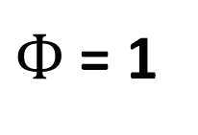
$Ф$ = 1
|
Impartial Culture (IC): Every preference order comes with the same proba-bility (a.k.a. uniform distribution)
|
> > >
> > >
Mallows Model: Choose a center vote u. The probability of generating vote v is:
$$\frac{1}{Z}Ф^{swap(u,v)}$$
(There are some algorithms that generate votes from this distribution… effectively.)
> > >
Impartial Culture (IC): Every preference order comes with the same proba-bility (a.k.a. uniform distribution)
> > >
> > >
> > >
> > >
> > >
> > >
> > >
Mallows Model: Choose a center vote u. The probability of generating vote v is:
$$\frac{1}{Z}Ф^{swap(u,v)}$$
There are fast sampling algorithms.
Polya-Eggenberger Urn Model: Form an urn of all possible m! votes. To generate a vote:
Choose a vote from the urn and add it to your election
Return the vote to the urn, together with α∙m! copies.
> > >
> > >
> > >
1
> > >
> > >
> > >
> > >
> > >
> > >
> > >
$$Ф$$
> > >
$$Ф2$$
> > >
> > >
> > >
> > >
> > >
$$Ф3+ …$$

Slide 13
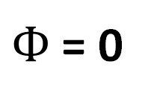
$Ф$ = 0
|
Impartial Culture (IC): Every preference order comes with the same proba-bility (a.k.a. uniform distribution)
|
Mallows Model: Choose a center vote u. The probability of generating vote v is:
$$\frac{1}{Z}Ф^{swap(u,v)}$$
(There are some algorithms that generate votes from this distribution… effectively.)
Impartial Culture (IC): Every preference order comes with the same proba-bility (a.k.a. uniform distribution)
Mallows Model: Choose a center vote u. The probability of generating vote v is:
$$\frac{1}{Z}Ф^{swap(u,v)}$$
There are fast sampling algorithms.
Polya-Eggenberger Urn Model: Form an urn of all possible m! votes. To generate a vote:
Choose a vote from the urn and add it to your election
Return the vote to the urn, together with α∙m! copies.
> > >

Slide 14
Statistical Cultures
|
Mallows Model: Choose a center vote u. The probability of generating vote v is:
$$\frac{1}{Z}Ф^{swap(u,v)}$$
(There are some algorithms that generate votes from this distribution… effectively.)
Impartial Culture (IC): Every preference order comes with the same proba-bility (a.k.a. uniform distribution)
Polya-Eggenberger Urn Model: Form an urn of all possible m! votes. To generate a vote:
Choose a vote from the urn and add it to your election
Return the vote to the urn, together with α∙m! copies.
|
Impartial Anonymous Culture: Choose each voting situation uniformly at random (effective: urn model with α = 1/m!)
So… what do these models actually do?

Slide 15
Microscope View of Elections

Slide 16
Swap Distance
d_{swap}( , )
= 2
> >
> >
Number of swaps of adjacent candidates needed to transform one preference order into the other

Slide 17
Swap Distance
= 1
d_{swap}( , )
= 2
> >
> >
Number of swaps of adjacent candidates needed to transform one preference order into the other

Slide 18
Swap Distance
= 0
d_{swap}( , )
= 1
> >
> >
Number of swaps of adjacent candidates needed to transform one preference order into the other

Slide 19
Swap Distance
d_{swap}( , )
= 0
> >
> >
Number of swaps of adjacent candidates needed to transform one preference order into the other
Election microscope:
Generate an election from a statistical culture
Compute swap distances between all pairs of votes
Represent each vote as a dot in 2D space, so that Euclidean distances are similar to the swap distances → map!

Slide 20
The Map Idea
We have some objects:
a, b, c, d ,e
We (somehow) know the distances between each pair
Can we arrange them in 2D space?
(1)
(2)
(3)
(4)

Slide 21
The Map Idea
We have some objects:
a, b, c, d ,e
We (somehow) know the distances between each pair
Can we arrange them in 2D space?
(1)
(2)
(3)
(4)

Slide 22
The Map Idea: Sometimes You Fail
Consider objects:
z₁, z₂, z₃, ... , z₁₀₀
For each i, j ∈ [100], we have:
d(z_{i},z_{j}) = 1
How to arrange these in the 2D space?
Not much you can do without errors…
But we still do it
z₃
z₁₄
z₆
z₉
z₁₈
z₁₂
z₁₅
z₁₀
z₁₇
z₁
z₅
z₂
z₁₆
z₁₉
z₁₃
z₂₀
z₈
z₇
z₁₁
z₄

Slide 23
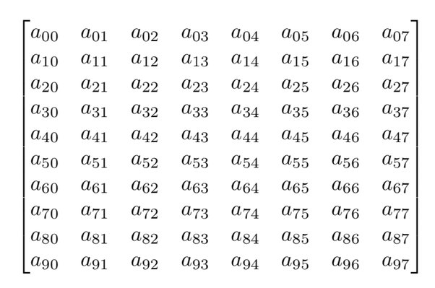
The Map Idea: Computing The Embedding
simple geometric dataset
(embedding algorithms only have Euclidean distances of points as inputs)
K. Sapała, Algorithms for Embedding Metrics in Euclidean Spaces, MSc thesis AGH 2022 (specialized implementation of Kamada-Kawai algorithm)

Slide 24
The Map Idea: Computing The Embedding
Examples of embeddings
ISOMAP
Kamada-Kawai (KK) with positions of corner points fixed
KK wihtout fixing
KK with Newton-Rhapson + fixing
KK with Newton-Rhapson without fixing
MDS
Simulated annealing with fixing
Simulated annealing without fixing
Fruchterman-Reingold
simple geometric dataset
(embedding algorithms only have Euclidean distances of points as inputs)
K. Sapała, Algorithms for Embedding Metrics in Euclidean Spaces, MSc thesis AGH 2022 (specialized implementation of Kamada-Kawai algorithm)

Slide 25
The Map Idea: Computing The Embedding
Examples of embeddings
ISOMAP
Kamada-Kawai (KK) with positions of corner points fixed
KK wihtout fixing
KK with Newton-Rhapson + fixing
KK with Newton-Rhapson without fixing
MDS
Simulated annealing with fixing
Simulated annealing without fixing
Fruchterman-Reingold
simple geometric dataset
(embedding algorithms only have Euclidean distances of points as inputs)
K. Sapała, Algorithms for Embedding Metrics in Euclidean Spaces, MSc thesis AGH 2022 (specialized implementation of Kamada-Kawai algorithm)

Slide 26
Swap Distance
d_{swap}( , )
= 0
> >
> >
Number of swaps of adjacent candidates needed to transform one preference order into the other
Election microscope:
Generate an election from a statistical culture
Compute swap distances between all pairs of votes
Represent each vote as a dot in 2D space, so that Euclidean distances are similar to the swap distances → map!

Slide 27
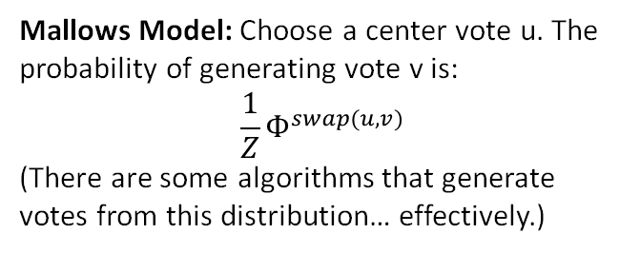
Microscope
|
Impartial Culture (IC): Every preference order comes with the same proba-bility (a.k.a. uniform distribution)
Polya-Eggenberger Urn Model: Form an urn of all possible m! votes. To generate a vote:
Choose a vote from the urn and add it to your election
Return the vote to the urn, together with α∙m! copies.
Mallows Model: Choose a center vote u. The probability of generating vote v is:
$$\frac{1}{Z}Ф^{swap(u,v)}$$
(There are some algorithms that generate votes from this distribution… effectively.)
Election microscope:
Generate an election from a statistical culture
Compute swap distances between all pairs of votes
Represent each vote as a dot in 2D space, so that Euclidean distances are similar to the swap distances (MDS)
8 candidates, 96 voters
8 candidates, 1000 voters
P. Faliszewski, A. Kaczmarczyk, K. Sornat, S. Szufa, T. Wąs, Diversity, Agreement and Polarization in Elections, IJCAI 2023

Slide 28
|
Impartial Culture (IC): Every preference order comes with the same proba-bility (a.k.a. uniform distribution)
Polya-Eggenberger Urn Model: Form an urn of all possible m! votes. To generate a vote:
Choose a vote from the urn and add it to your election
Return the vote to the urn, together with α∙m! copies.
Mallows Model: Choose a center vote u. The probability of generating vote v is:
$$\frac{1}{Z}Ф^{swap(u,v)}$$
(There are some algorithms that generate votes from this distribution… effectively.)
Election microscope:
Generate an election from a statistical culture
Compute swap distances between all pairs of votes
Represent each vote as a dot in 2D space, so that Euclidean distances are similar to the swap distances (MDS)
8 candidates, 96 voters
8 candidates, 1000 voters

Slide 29
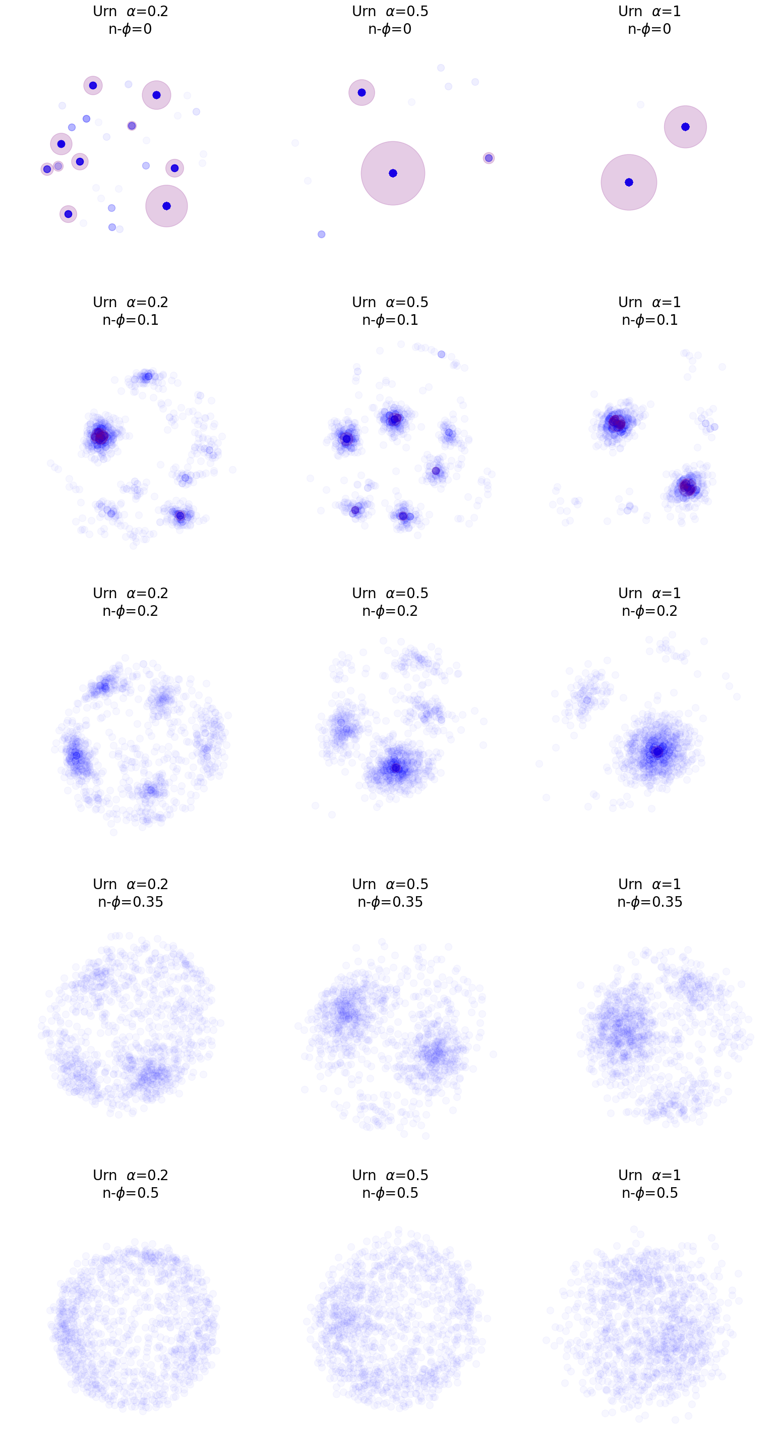
|
Impartial Culture (IC): Every preference order comes with the same proba-bility (a.k.a. uniform distribution)
Urn-Mallows Model: First generate an election according to the urn model and then replace each vote v with one generated using Mallows model, with v as the center vote.
Polya-Eggenberger Urn Model: Form an urn of all possible m! votes. To generate a vote:
Choose a vote from the urn and add it to your election
Return the vote to the urn, together with α∙m! copies.
Comparison to real-life elections:
Sushi contains preferences about sushi types. Grenoble and Irish are political elections
Mallows Model: Choose a center vote u. The probability of generating vote v is:
$$\frac{1}{Z}Ф^{swap(u,v)}$$
(There are some algorithms that generate votes from this distribution… effectively.)
Election microscope:
Generate an election from a statistical culture
Compute swap distances between all pairs of votes
Represent each vote as a dot in 2D space, so that Euclidean distances are similar to the swap distances (MDS)
Question:
Urn-Mallows looks like a nice, useful model of generating data. How can we justify it is good? What can we prove? What is it good for?

Slide 30
Microscope of Structured Domains
Euclidean Model: Choose points for the voters and candidates from Euclidean space R^{t}. Voter v prefers candidate x to y if x’s point is closer to v than y’s.
Single-Peaked: There is societal axis (order of the of the candidates). Every single-peaked vote for this axis satisfies the property that „for each t, the top t candidates form an interval on the axis”.
8 candidates, 96 voters
SPOC: Like SP, but the axis is cyclic
Single-Crossing: It is possible to order the voters so that as we go along this order, the relative ranking of two candidates changes at most once
Group-Separable: Trees, trees everywhere!
8 candidates, 1000 voters

Slide 31
P. Faliszewski, A. Kaczmarczyk, K. Sornat, S. Szufa, T. Wąs, Diversity, Agreement and Polarization in Elections, IJCAI 2023

Slide 32
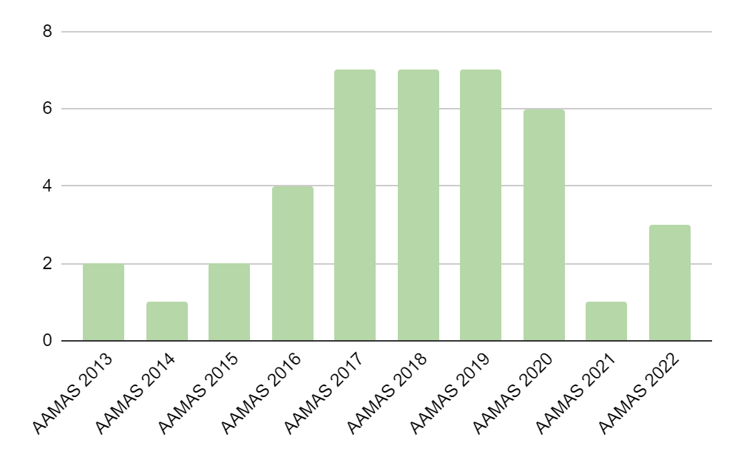
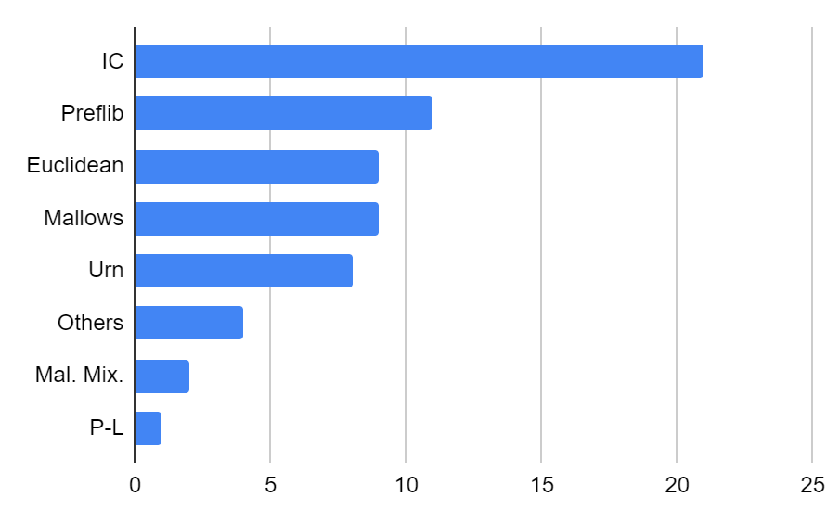
Which Cultures Are Used?
Common statistical cultures in AAMAS research (just a snapshot! Now looking at AAAI and IJCAI and others!)
Grain of salt warning!

Slide 33
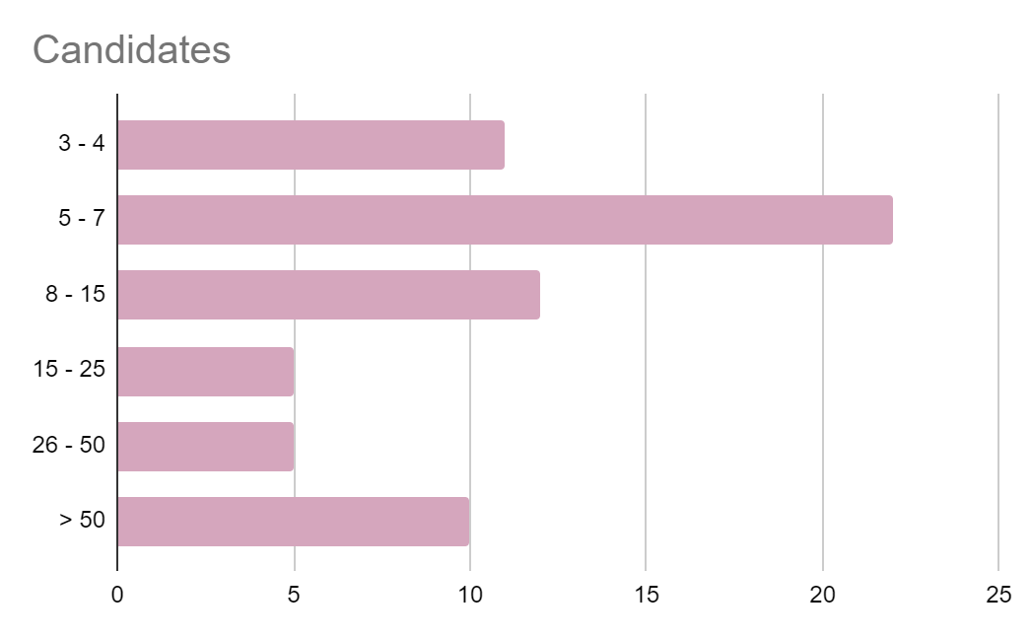
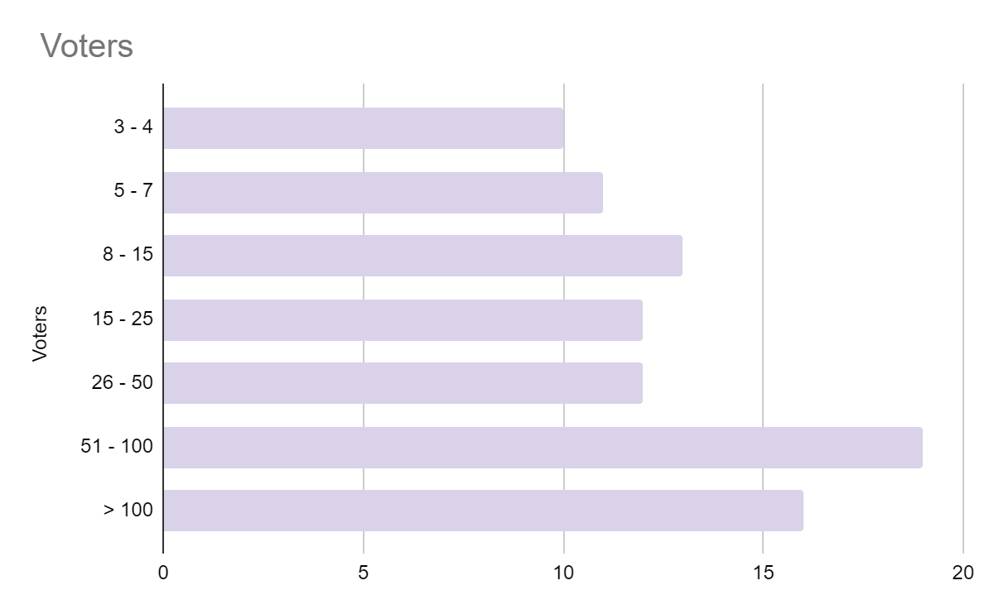
What Election Sizes?
Common statistical cultures in AAMAS research (just a snapshot! Now looking at AAAI and IJCAI and others!)
Grain of salt warning!

Slide 34
Map of Elections: Bird’s Eye View

Slide 35



v₁: > >
How different?
v₁: > >
v₂: > >
v₂: > >
v₃: > >
v₃: > >
v₄: > >
UN
ID
v₄: > >
v₅: > >
v₅: > >
Count the number of swaps that make the elections isomorphic (i.e., identical up to renaming the candidates and reordering the voters)
v₆: > >
v₆: > >
all possible preference orders
uniformity
Identical preference orders
identity

Slide 36
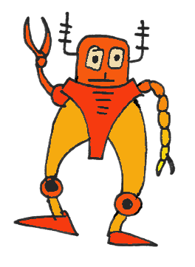
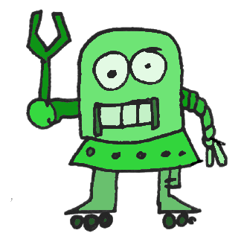
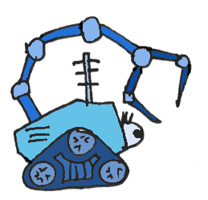
Isomorphic Swap Distance
> >
> >
> >
> >
> >
> >
Match the candidates
Match the voters
Count the swaps
P. Faliszewski, P. Skowron, A. Slinko, S. Szufa, N. Talmon: How Similar Are Two Elections? AAAI 2019

Slide 37
Isomorphic Swap Distance
> >
> >
> >
> >
> >
> >
Match the candidates
Match the voters
Count the swaps
P. Faliszewski, P. Skowron, A. Slinko, S. Szufa, N. Talmon: How Similar Are Two Elections? AAAI 2019

Slide 38
Isomorphic Swap Distance
> >
> >
> >
> >
> >
> >
Match the candidates
Match the voters
Count the swaps
P. Faliszewski, P. Skowron, A. Slinko, S. Szufa, N. Talmon: How Similar Are Two Elections? AAAI 2019

Slide 39
Isomorphic Swap Distance
> >
> >
> >
> >
> >
> >
Match the candidates
Match the voters
Count the swaps
P. Faliszewski, P. Skowron, A. Slinko, S. Szufa, N. Talmon: How Similar Are Two Elections? AAAI 2019

Slide 40
Isomorphic Swap Distance
> >
> >
d( , )=1
> >
> >
> >
> >
Match the candidates
Match the voters
Count the swaps
P. Faliszewski, P. Skowron, A. Slinko, S. Szufa, N. Talmon: How Similar Are Two Elections? AAAI 2019

Slide 41
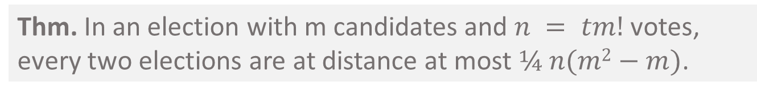
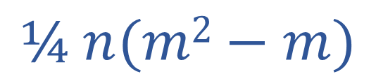
Thm. In an election with m candidates and $n = tm!$ votes, every two elections are at distance at most $¼ n(m2−m)$.
v₁: > >
v₁: > >
v₂: > >
$$¼ n(m2−m)$$
v₂: > >
v₃: > >
v₃: > >
v₄: > >
UN
ID
v₄: > >
v₅: > >
v₅: > >
Count the number of swaps that make the elections isomorphic (i.e., identical up to renaming the candidates and reordering the voters)
v₆: > >
v₆: > >
all possible preference orders
uniformity
Identical preference orders
identity
N. Boehmer, P. Faliszewski, R. Niedermeier, S. Szufa, T. Wąs, Understanding Distance Measures Among Elections, IJCAI 2022

Slide 42
v₁: > >
v₁: > >
v₂: > >
v₂: > >
1
v₃: > >
v₃: > >
v₄: > >
UN
ID
v₄: > >
v₅: > >
v₅: > >
v₆: > >
v₆: > >
all possible preference orders
uniformity
Identical preference orders
identity
N. Boehmer, P. Faliszewski, R. Niedermeier, S. Szufa, T. Wąs, Understanding Distance Measures Among Elections, IJCAI 2022

Slide 43

v₁: > > >
v₂: > > >
two reverse orders
antagonism
AN
v₃: > > >
v₄: > > >
v₅: > > >
v₆: > > >
v₁: > > >
v₁: > > >
v₂: > > >
1
v₂: > > >
v₃: > > >
v₃: > > >
UN
ID
v₄: > > >
v₄: > >
>
v₅: > > >
v₅: > >
>
v₁: > > >
v₆: > > >
v₆: > >
>
v₂: > > >
v₃: > > >
two groups of candidates,
each voter prefers members
of one group to the other
stratification
v₄: > >
>
ST
v₅: > >
>
v₆: > >
>

Slide 44
v₁: > > >
v₂: > > >
two reverse orders
antagonism
AN
v₃: > > >
v₄: > > >
≈1
v₅: > > >
v₆: > > >
v₁: > > >
1
v₁: > > >
v₂: > > >
1
v₂: > > >
v₃: > > >
v₃: > > >
UN
ID
v₄: > > >
v₄: > >
>
v₅: > > >
v₅: > >
>
v₁: > > >
v₆: > > >
v₆: > >
>
v₂: > > >
v₃: > > >
two groups of candidates,
each voter prefers members
of one group to the other
stratification
v₄: > >
>
ST
v₅: > >
>
v₆: > >
>

Slide 45
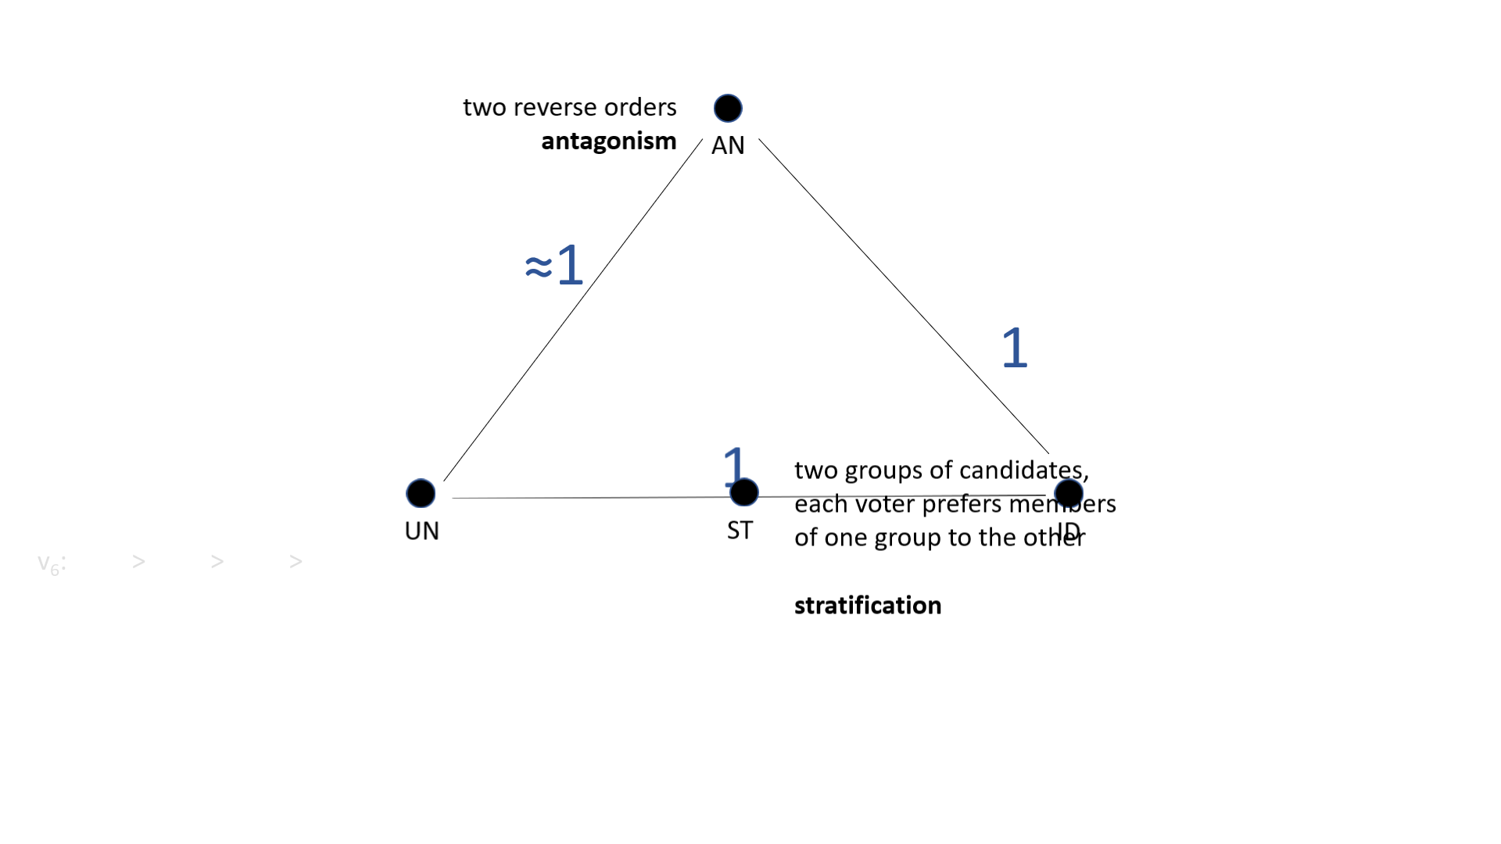
Somehow difficult to compute exactly
(is there a mathematician in the room?)
Thm. An election is at (normalized) distance 1 from ID if and only if for all pairs of candidates a and b, half of the voters prefer a to b, and half of the voters prefer b to a.

Slide 46
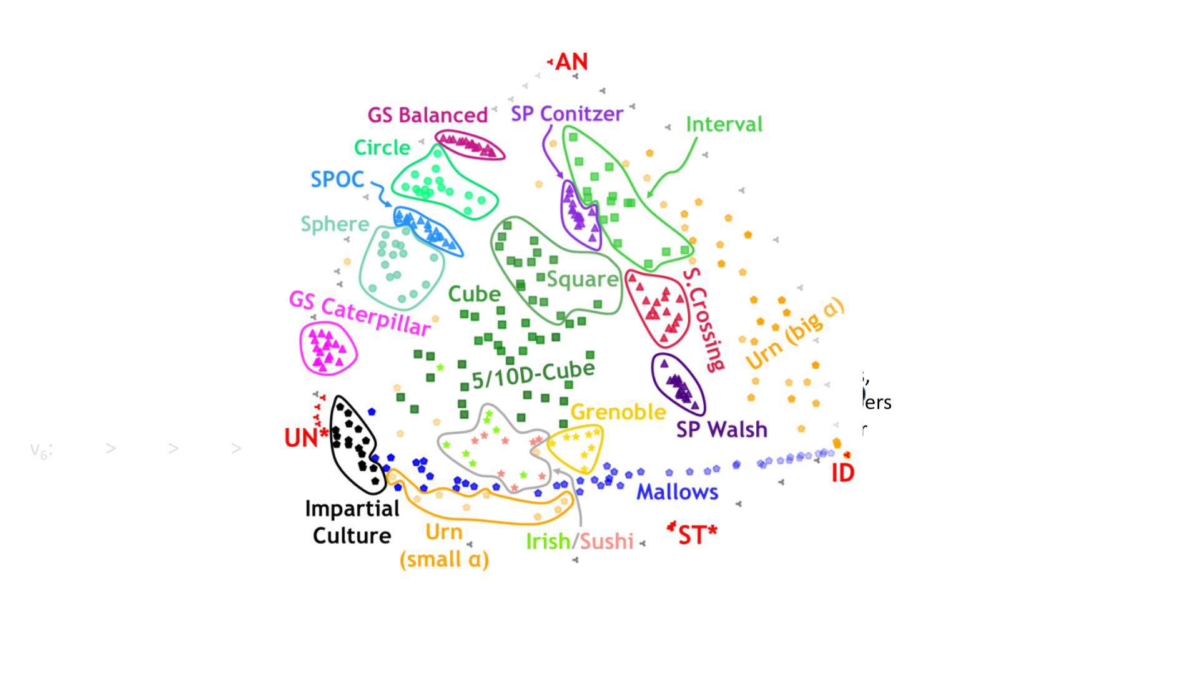
Somehow difficult to compute exactly
(is there a mathematician in the room?)
P. Faliszewski, A. Kaczmarczyk, K. Sornat, S. Szufa, T. Wąs, Diversity, Agreement and Polarization in Elections, IJCAI 2023

Slide 47
P. Faliszewski, A. Kaczmarczyk, K. Sornat, S. Szufa, T. Wąs, Diversity, Agreement and Polarization in Elections, IJCAI 2023

Slide 48

Computing Isomorphic Swap distance is:
NP-hard
Hard to approximate
  O(m)-approx. and no better
FPT-computable, but impractical
Infeasible using ILP
Just plain tough!
Bruteforce works up to 10x50 elections, if you have hundreds of cores and plenty of time…
P. Faliszewski, P. Skowron, A. Slinko, S. Szufa, N. Talmon: How Similar Are Two Elections? AAAI 2019

Slide 49
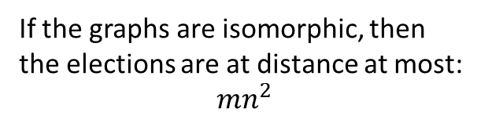
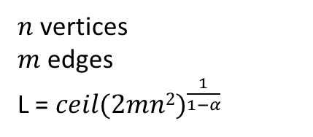

Inapproximabiltiy of Isomorphic Swap Distance
Assume ${|C|}^{α}$-approximation, polynomial-time algorithm for our distance, $α$ < 1
$n$ vertices
$m$ edges
L = ${ceil(2mn2)}^{\frac{1}{1−α}}$
Instance of Graph Isomorphism
Elections
…
e₁₂: v₄ > v₆ > d₁ > … > d_{L} > V – {v₄, v₆}
e₁₃: v₇ > v₁ > d₁ > … > d_{L} > V – {v₇, v₁}
e₁₄: v_{a} > v_{b} > d₁ > … > d_{L} > V – {v_{a}, v_{b}}
e₁₅: v₈ > v₃ > d₁ > … > d_{L} > V – {v₃, v₈}
e₁₆: v₂ > v₉ > d₁ > … > d_{L} > V – {v₂, v₉}
…
If the graphs are isomorphic, then the elections are at distance at most:
${mn}^{2}$
e₁₄
v_{b}
G:
E:
v_{a}
Our algorithm outputs at most:
${mn}^{2}{(n+L)}^{α}={mn}^{2}{(1+\frac{n}{L})}^{α}L^{α}<2mn^{2}L^{α−1}L=\frac{{2mn}^{2}L}{{\left({ceil(2mn2)}^{\frac{1}{1−α}}\right)}^{1−α}}≤L$
…
f₄₀: u₁₄ > u₆₆ > d’₁ > … > d’_{L} > V – {u₁₄, u₆₆}
f₄₁: u₂₅ > u₁₀ > d’₁ > … > d’_{L} > V – {u₂₅, u₁₀}
f₄₂: u_{a} > u_{b} > d’₁ > … > d’_{L} > V – {u_{a} , u_{b}}
f₄₃: u₄₆ > u₃₁ > d’₁ > … > d’_{L} > V – {u₄₆, u₃₁}
f₄₄: u₂₁ > u₂₇ > d’₁ > … > d’_{L} > V – {u₂₁, u₂₇}
…
G’:
E’:
Otherwise it outputs more than $L$
u_{y}
u_{x}
f₄₂

Slide 50
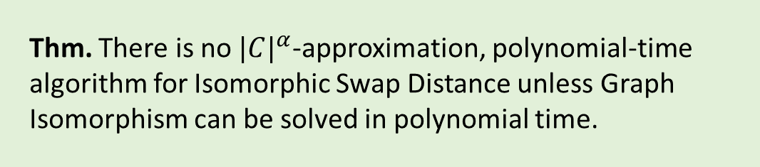
Inapproximabiltiy of Isomorphic Swap Distance
Assume ${|C|}^{α}$-approximation, polynomial-time algorithm for our distance, $α$ < 1
$n$ vertices
$m$ edges
L = ${ceil(2mn2)}^{\frac{1}{1−α}}$
Thm. There is no ${|C|}^{α}$-approximation, polynomial-time algorithm for Isomorphic Swap Distance unless Graph Isomorphism can be solved in polynomial time.
Instance of Graph Isomorphism
Elections
…
e₁₂: v₄ > v₆ > d₁ > … > d_{L} > V – {v₄, v₆}
e₁₃: v₇ > v₁ > d₁ > … > d_{L} > V – {v₇, v₁}
e₁₄: v_{a} > v_{b} > d₁ > … > d_{L} > V – {v_{a}, v_{b}}
e₁₅: v₈ > v₃ > d₁ > … > d_{L} > V – {v₃, v₈}
e₁₆: v₂ > v₉ > d₁ > … > d_{L} > V – {v₂, v₉}
…
If the graphs are isomorphic, then the elections are at distance at most:
${mn}^{2}$
e₁₄
v_{b}
G:
Question 1. Can we improve inapproximability assumption to P ≠ NP?
E:
v_{a}
Our algorithm outputs at most:
${mn}^{2}{(n+L)}^{α}={mn}^{2}{(1+\frac{n}{L})}^{α}L^{α}<2mn^{2}L^{α−1}L=\frac{{2mn}^{2}L}{{\left({ceil(2mn2)}^{\frac{1}{1−α}}\right)}^{1−α}}≤L$
…
f₄₀: u₁₄ > u₆₆ > d’₁ > … > d’_{L} > V – {u₁₄, u₆₆}
f₄₁: u₂₅ > u₁₀ > d’₁ > … > d’_{L} > V – {u₂₅, u₁₀}
f₄₂: u_{a} > u_{b} > d’₁ > … > d’_{L} > V – {u_{a} , u_{b}}
f₄₃: u₄₆ > u₃₁ > d’₁ > … > d’_{L} > V – {u₄₆, u₃₁}
f₄₄: u₂₁ > u₂₇ > d’₁ > … > d’_{L} > V – {u₂₁, u₂₇}
…
Question 2. Can we find good, mildly exponential (FPT?) approximation algorithms or approximation schemes?
G’:
E’:
Otherwise it outputs more than $L$
u_{y}
u_{x}
f₄₂

Slide 51
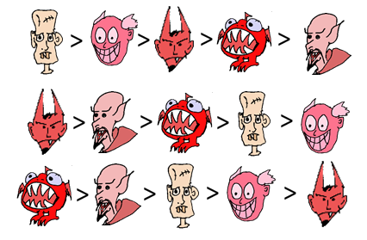
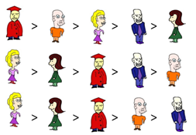





Positionwise Distance
= (0, 1, 0, 1, 1)
4
= (1, 0, 2, 0, 0)
2
= (0, 2, 0, 0, 1)
= (1, 0, 1, 1, 0 )
= (1, 0, 1, 1, 0 )
= (1, 0, 1, 0, 1 )
0
= (0, 2, 0, 0, 1)
= (0, 1, 0, 1, 1 )
= (2, 0, 1, 0, 0 )
= (0, 0, 0, 2, 1 )
6
2
Earthmover distances
S. Szufa, P. Faliszewski, P. Skowron, A. Slinko, N. Talmon, Drawing a Map of Elections in the Space of Statistical Cultures, AAMAS 2022

Slide 52
Positionwise Distance
= (0, 1, 0, 1, 1)
4
= (1, 0, 2, 0, 0)
2
= (0, 2, 0, 0, 1)
= (1, 0, 1, 1, 0 )
= (1, 0, 1, 1, 0 )
= (1, 0, 1, 0, 1 )
0
= (0, 2, 0, 0, 1)
= (0, 1, 0, 1, 1 )
= (2, 0, 1, 0, 0 )
= (0, 0, 0, 2, 1 )
6
2
S. Szufa, P. Faliszewski, P. Skowron, A. Slinko, N. Talmon, Drawing a Map of Elections in the Space of Statistical Cultures, AAMAS 2022

Slide 53
Positionwise Distance
= (0, 1, 0, 1, 1)
= (1, 0, 2, 0, 0)
1
0
= (0, 2, 0, 0, 1)
= (1, 0, 1, 1, 0 )
= (1, 0, 1, 1, 0 )
= (1, 0, 1, 0, 1 )
= (0, 2, 0, 0, 1)
= (0, 1, 0, 1, 1 )
= (2, 0, 1, 0, 0 )
= (0, 0, 0, 2, 1 )
0
5
4
distance = 1+0+0+5+4 = 10

Slide 54
v₁: > > >
Frequency Matrix
two reverse orders
antagonism
AN
v₂: > > >
v₃: > > >
1 1/3 2/3 0
2 1/3 1/3 1/3
3 1/3 0 2/3
v₄: > > >
v₅: > > >
v₆: > > >
v₁: > > >
v₁: > > >
v₂: > > >
1
v₂: > > >
v₃: > > >
v₃: > > >
UN
ID
v₄: > > >
v₄: > >
>
v₅: > > >
v₅: > >
>
v₁: > > >
v₆: > > >
v₆: > >
>
v₂: > > >
v₃: > > >
two groups of candidates,
each voter prefers members
of one group to the other
stratification
v₄: > >
>
ST
v₅: > >
>
v₆: > >
>

Slide 55




v₁: > > >
Frequency Matrix
v₂: > > >
v₃: > > >
1 1/3 2/3 0
2 1/3 1/3 1/3
3 1/3 0 2/3
v₄: > > >
v₅: > > >
v₆: > > >
v₁: > > >
v₁: > > >
v₂: > > >
1
v₂: > > >
v₃: > > >
v₃: > > >
v₄: > > >
v₄: > >
>
v₅: > > >
v₅: > >
>
v₁: > > >
v₆: > > >
v₆: > >
>
v₂: > > >
v₃: > > >
v₄: > >
>
v₅: > >
>
v₆: > >
>

Slide 56
½
¾
¹³/₁₆
1
½
¾
N. Boehmer, R. Bredereck, P. Faliszewski, R. Niedermeier, S. Szufa: Putting a Compass on the Map of Elections, IJCAI 2021

Slide 58
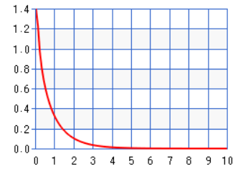
Normalized Urn Model is Normalized
Gamma(0.8,1)
density function

Slide 59
Mallows Model: Standard dispersion parameter Φ versus norm-Φ
Consider normalization for Mallows!

Slide 61
Candidate Scores

Slide 62
ILP Running Times

Slide 63
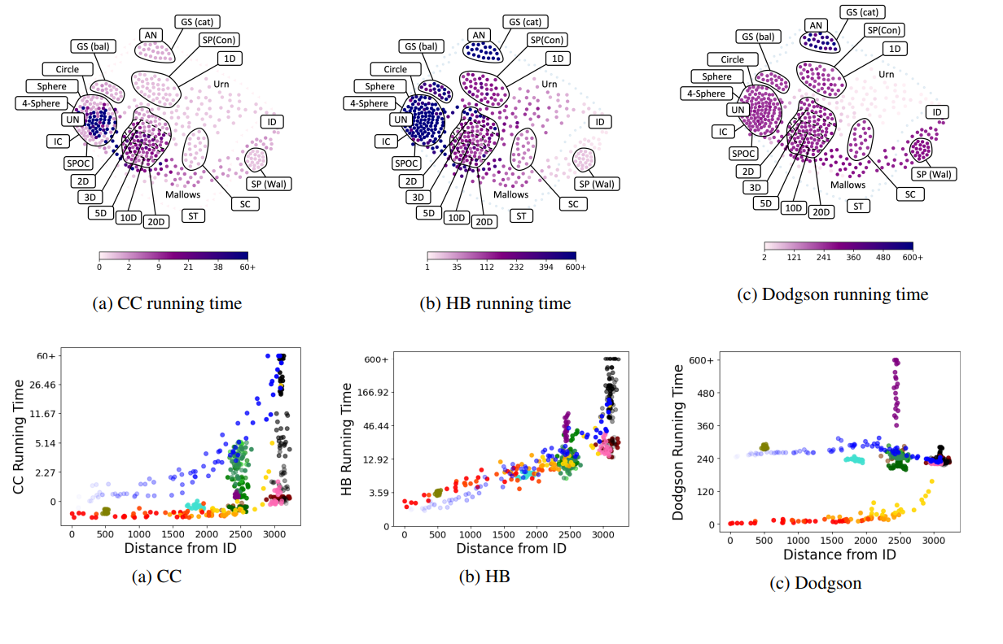

Slide 64
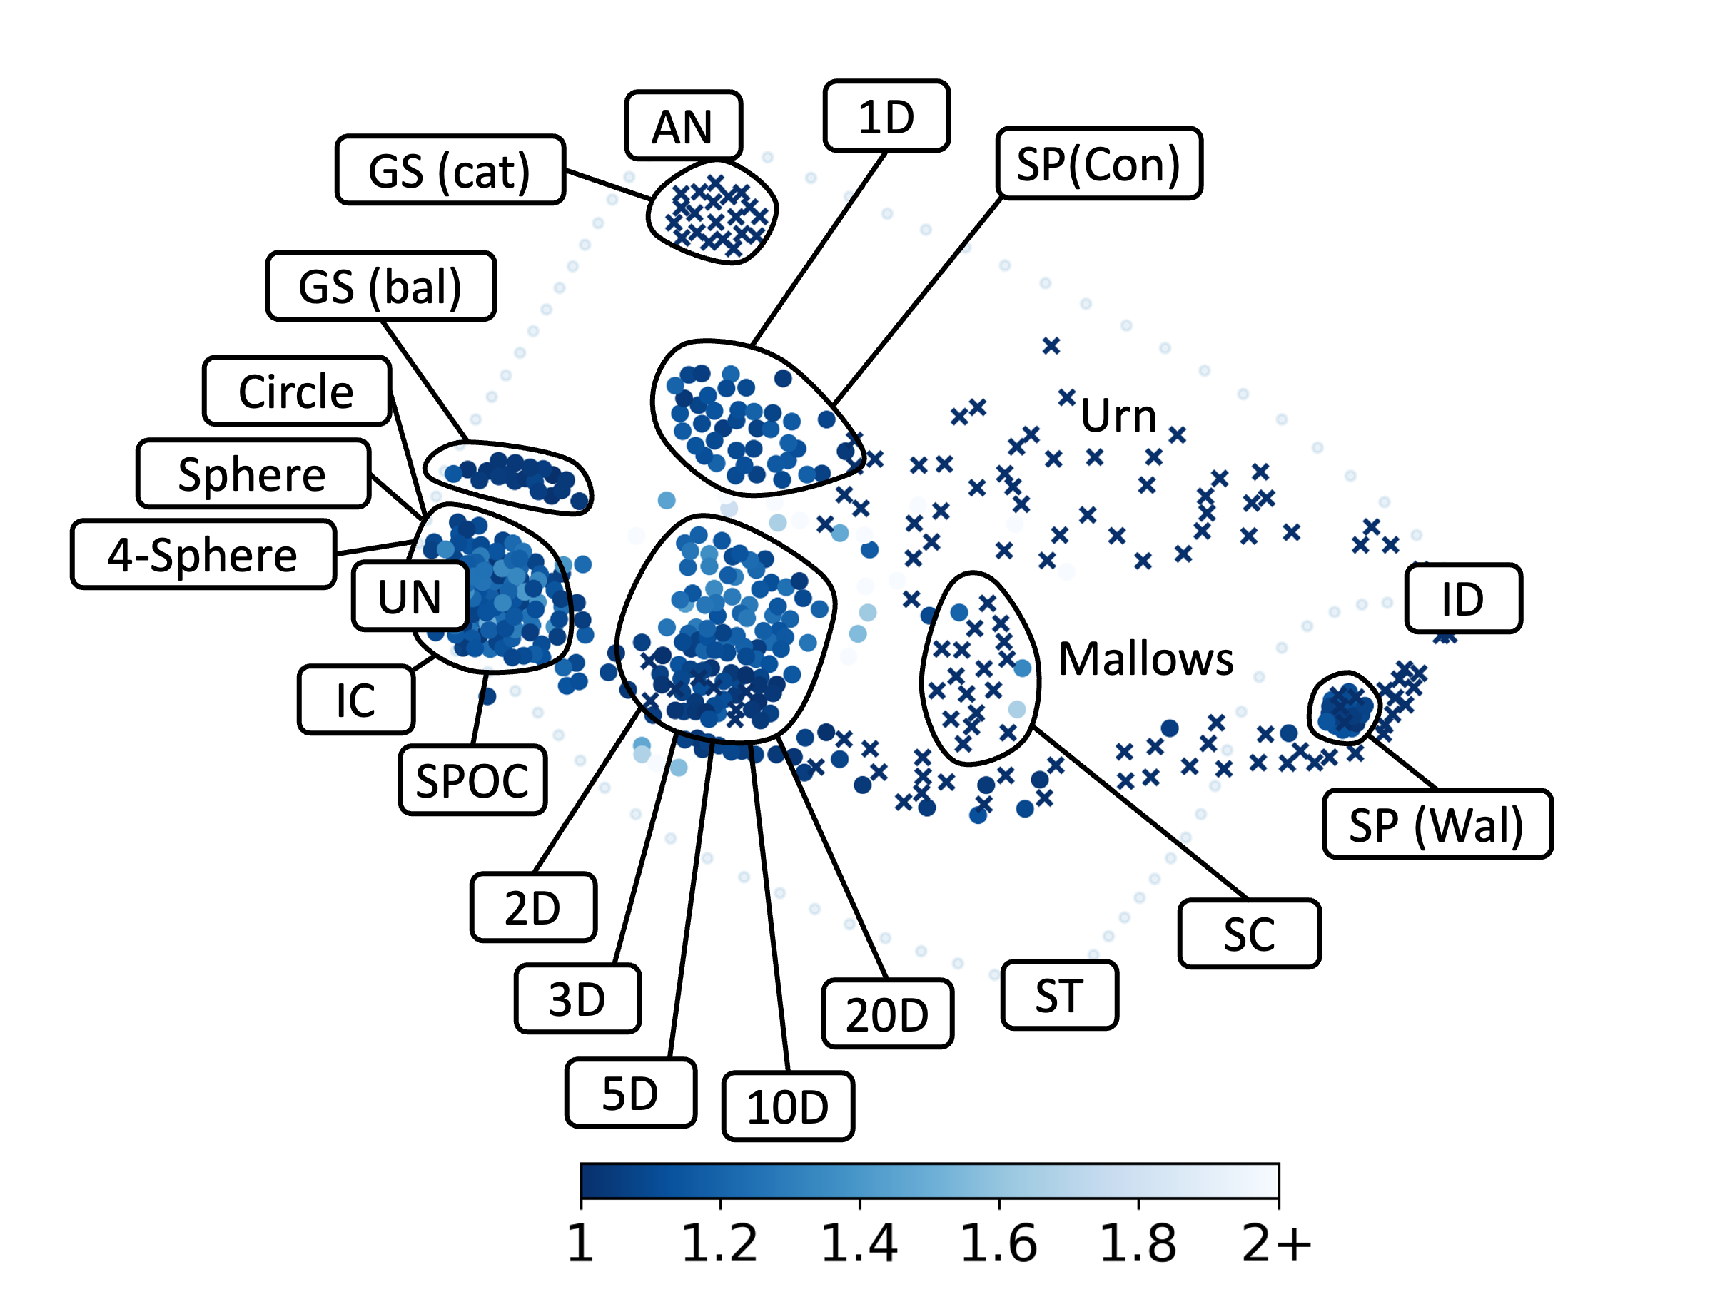
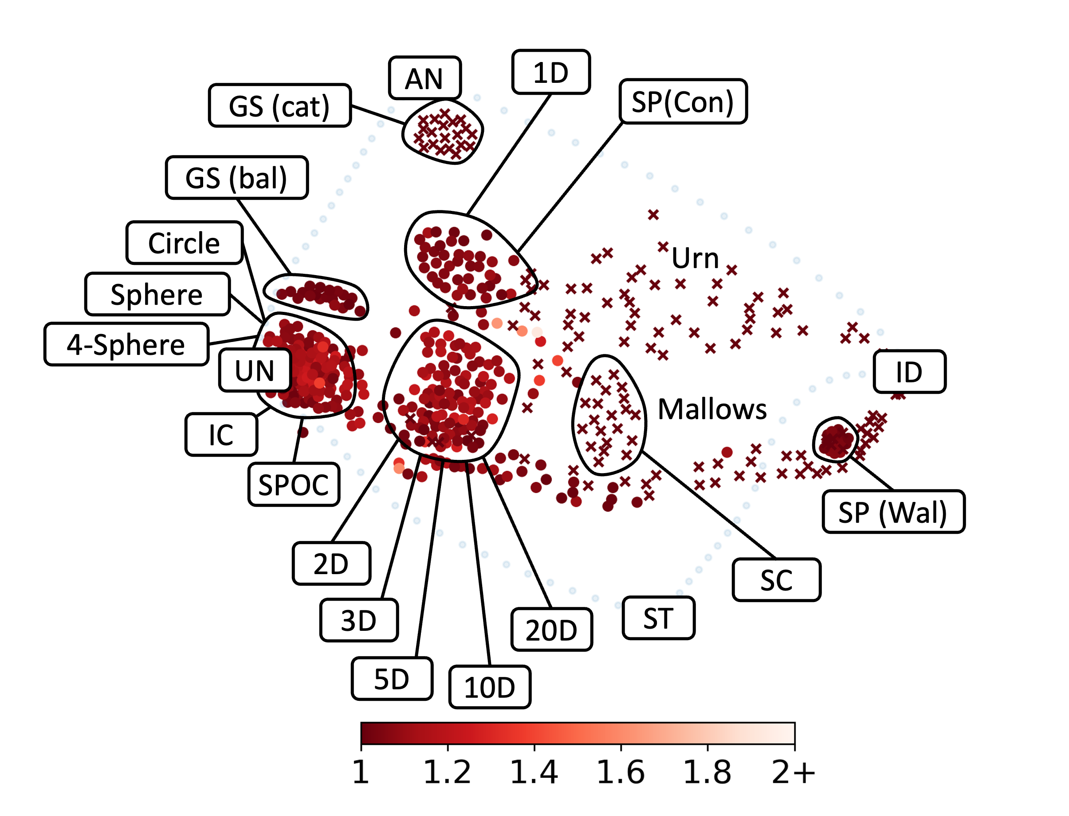
CC Approximation Algorithms
In each step, add the candidate
who increases the committee's score the most
In each step, remove the candidate
who decreases the committee's score the least
Sequential CC Approx. Ratio
Removal CC Approx. Ratio

Slide 65
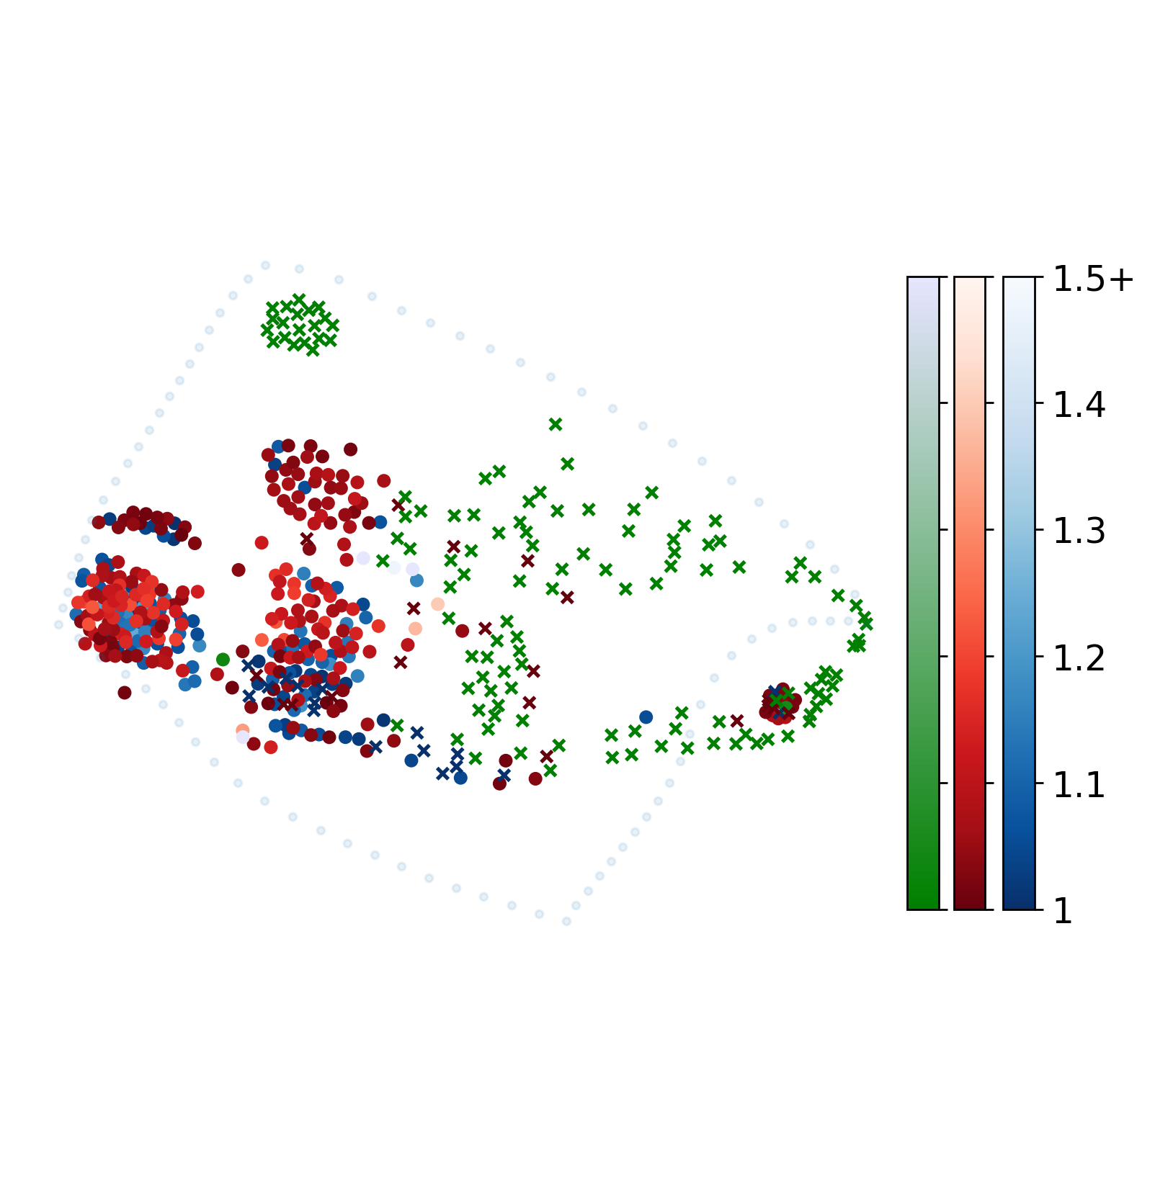
greedy_approx_hb_score_normalized_dissat_vs_removal_approx_hb_score_normalized_dissat
CC Approximation Algorithms
AN
1D
GS (cat)
SP(Con)
GS (bal)
Circle
Urn
Sphere
4-Sphere
UN
ID
Mallows
IC
SPOC
SP (Wal)
2D
SC
3D
20D
ST
5D
10D
Sequential CC vs Removal CC

Slide 66
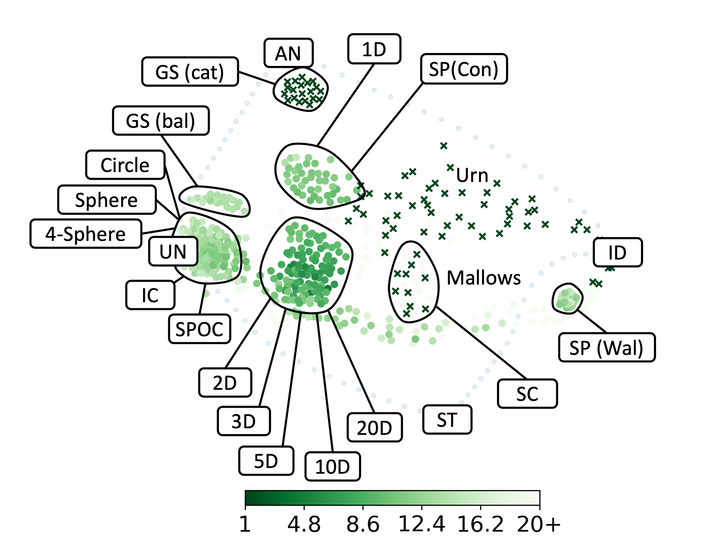
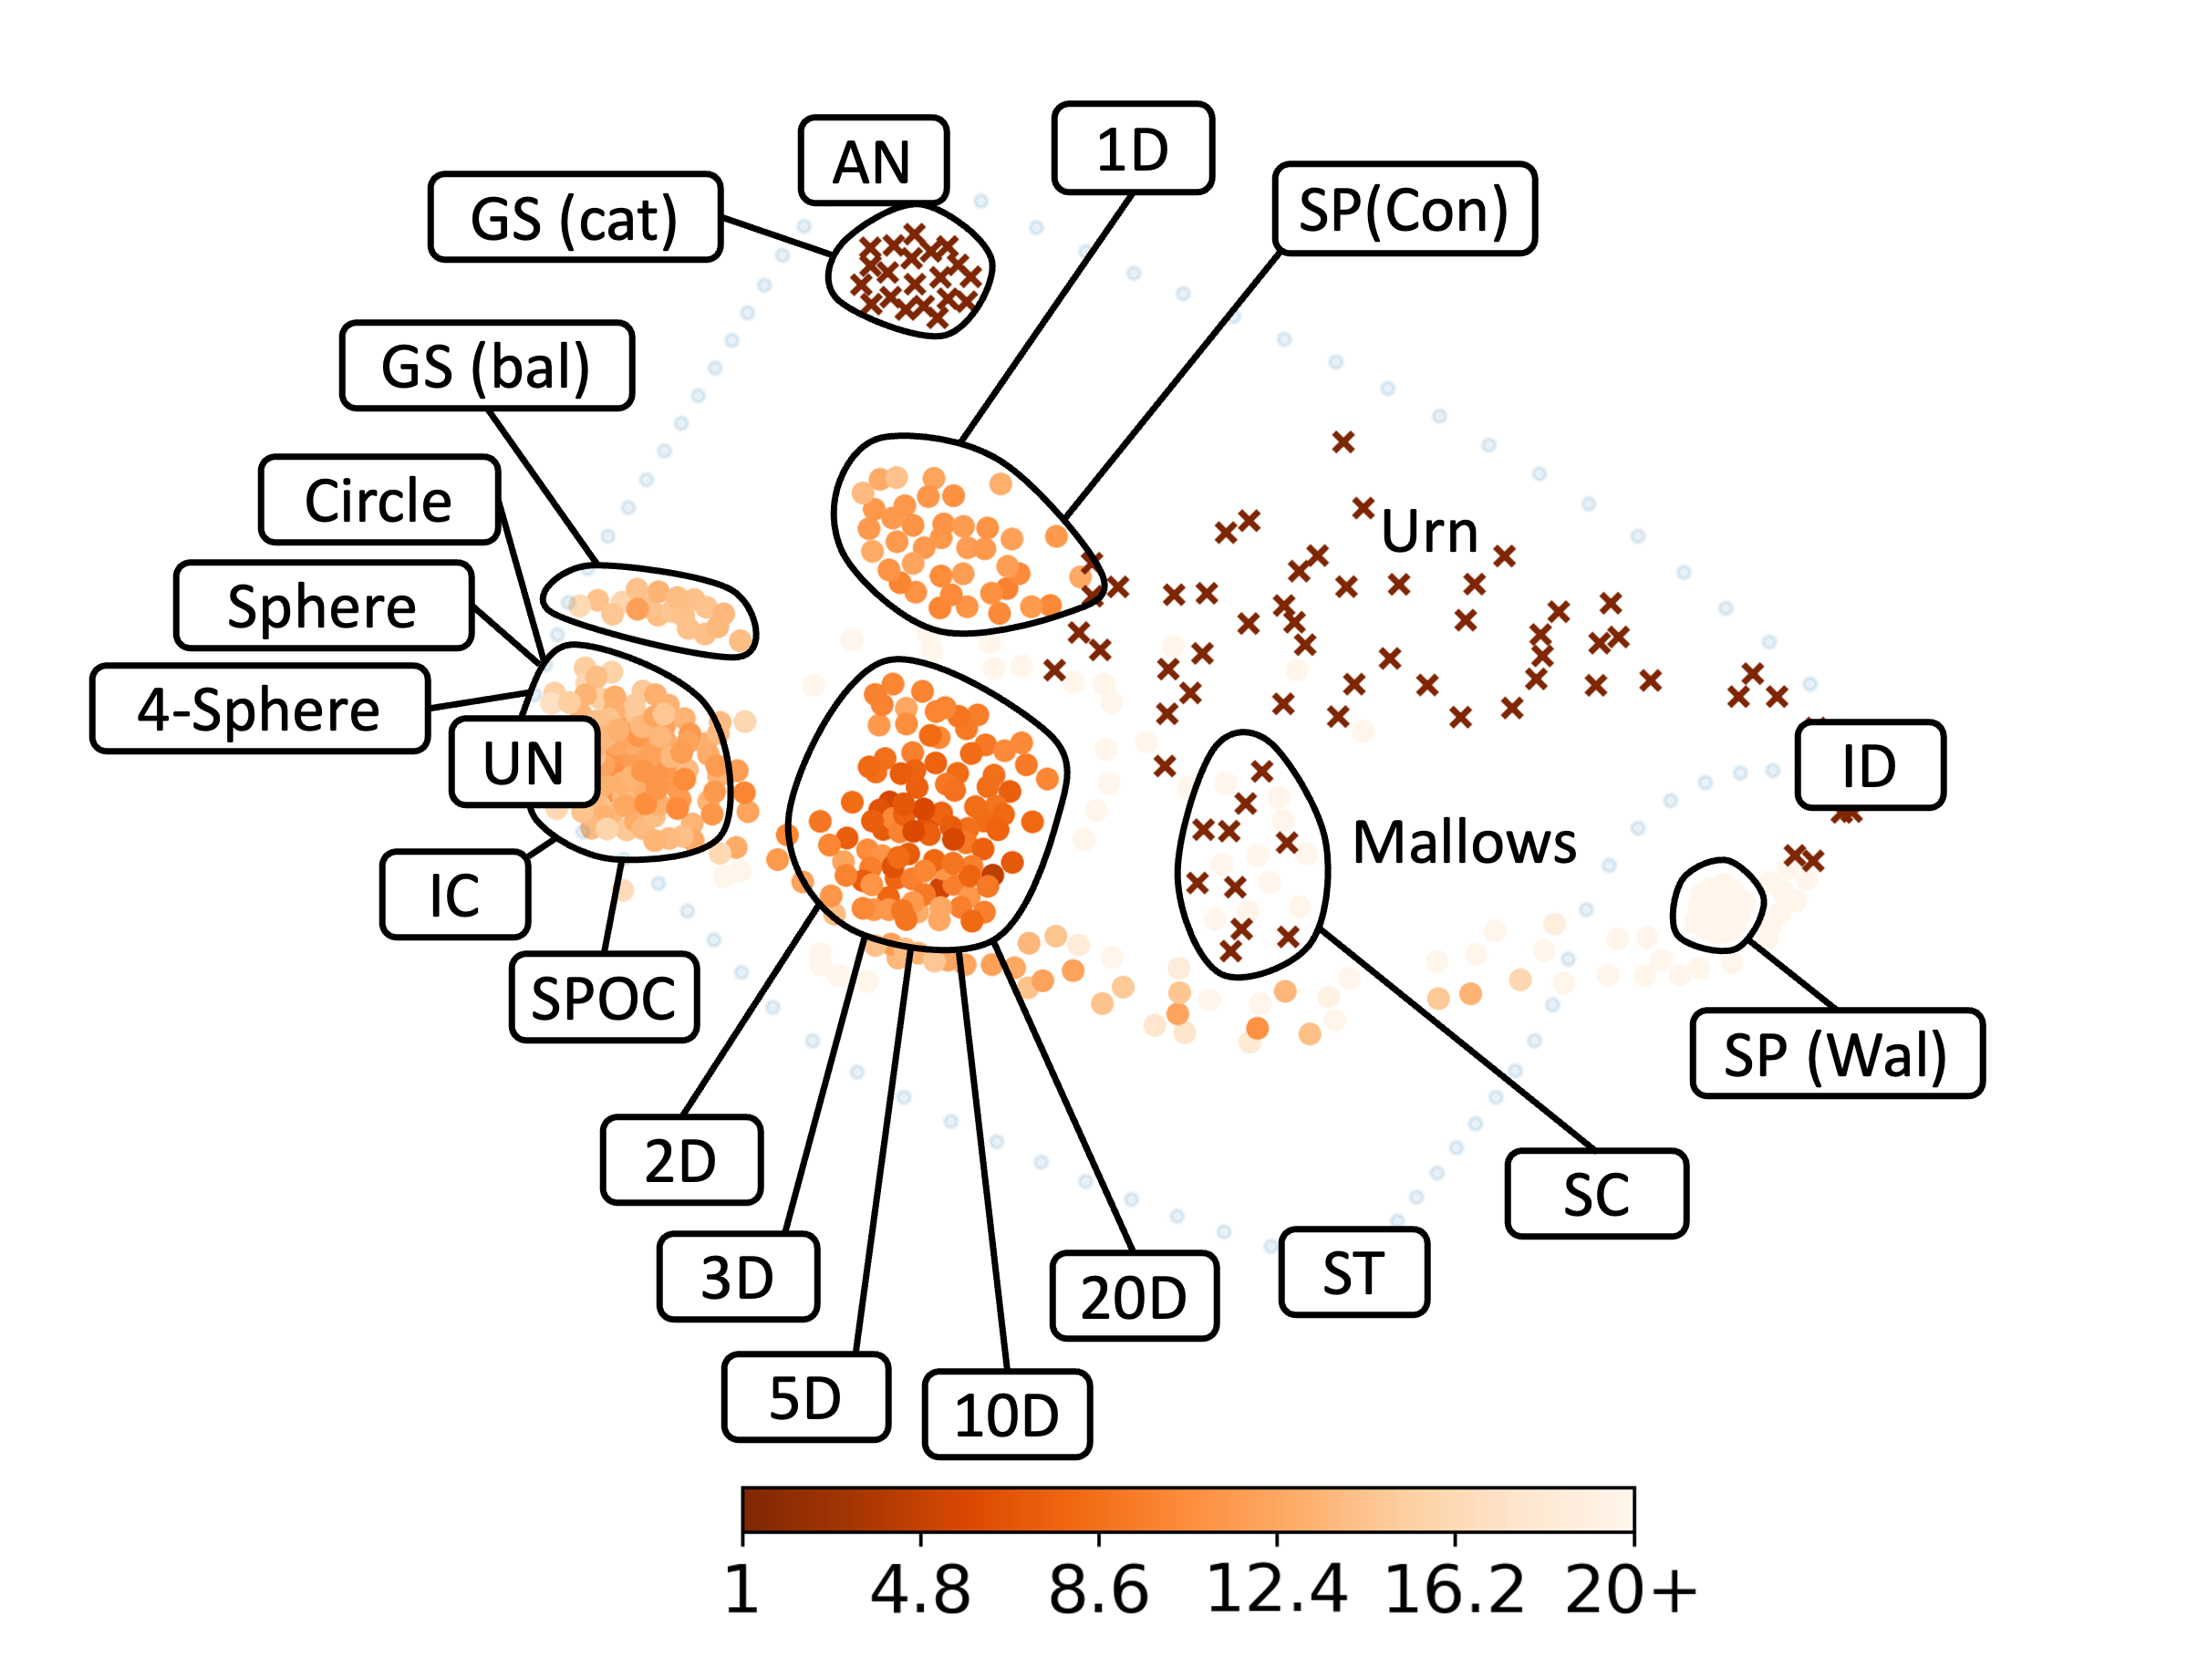
Banzhaf CC Approx. Ratio
Sequential CC Approx. Ratio
Ranging CC Approx. Ratio
Removal CC Approx. Ratio

Slide 67
Putting Real-World Elections on the Map
Notes:
TTwo purposes: Give an overview of real-world data sources + learn something

Slide 68
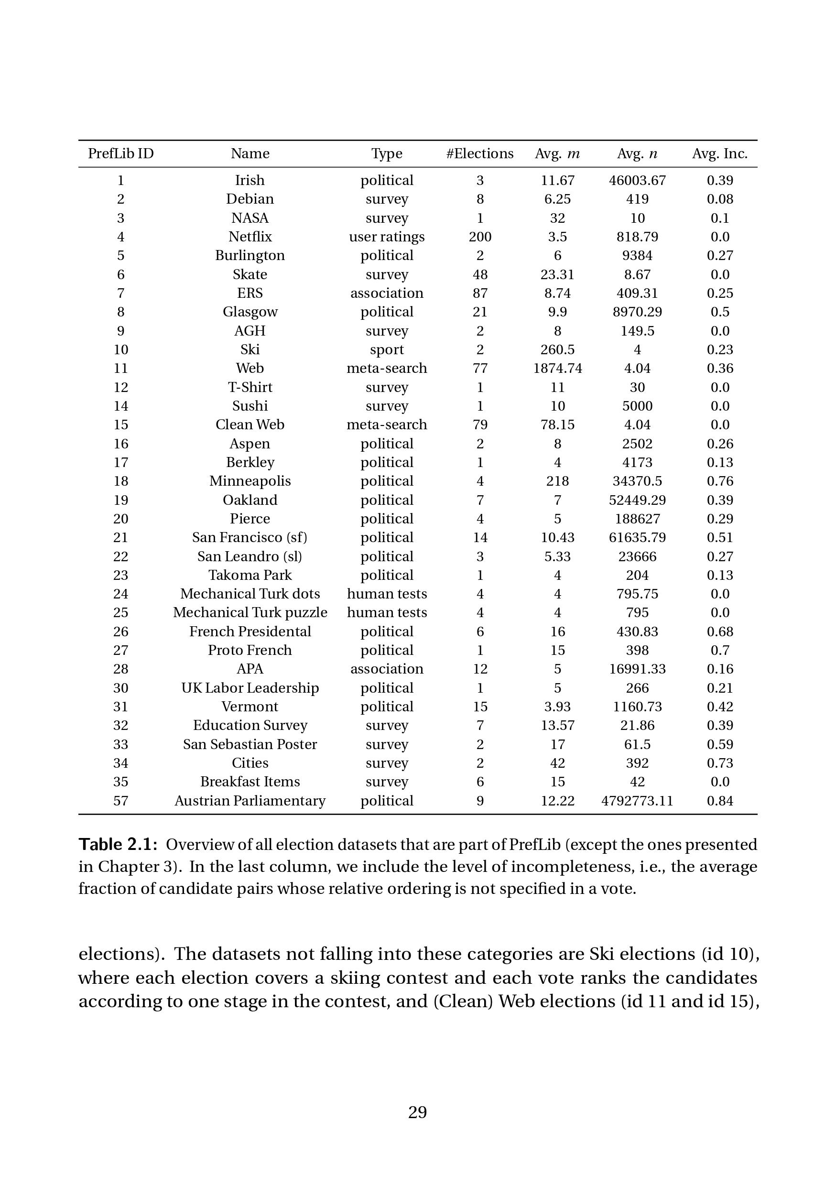
Preflib Data
637 elections from 35 datasets of different types:
  Humans expressing opinions concerning candidates for a position (political, association)
  Humans expressing preferences over objects (survey, user ratings)
  Humans ranking items as part of a test (human tests)
Decisive features:
Typcially below 10 candidates or below 10 voters.
Often highly incomplete votes, voters typically rank only small subset of candidates.
Usable for map:
Irish, Skate, ERS, Glasgow, T-Shirt, Sushi, Aspen, and Cities

Slide 69
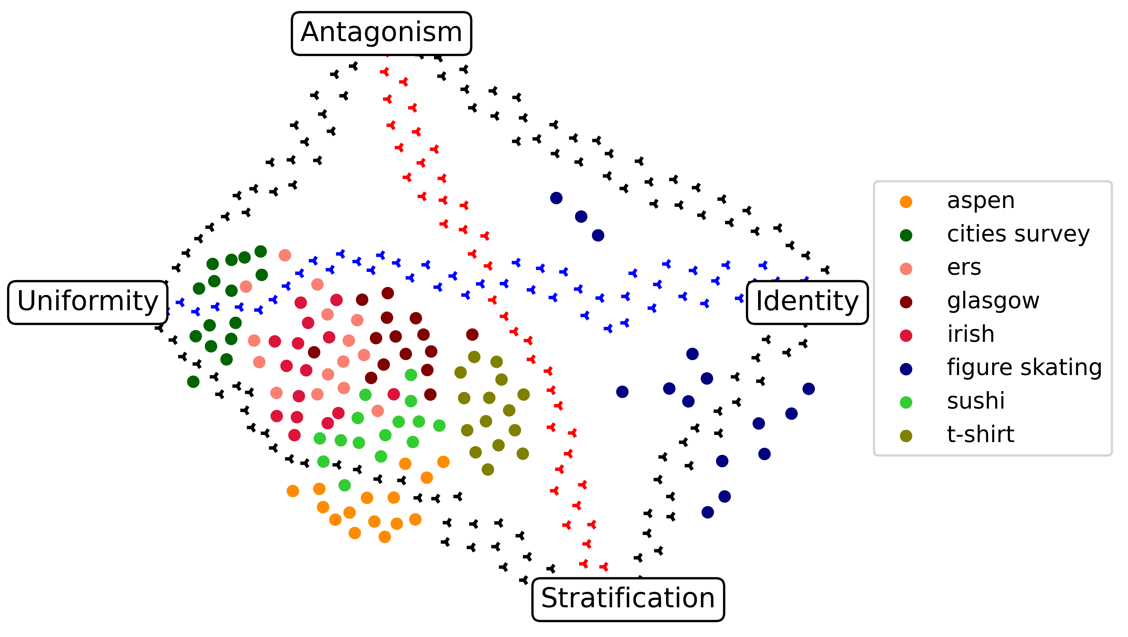
Map of Preflib Elections
Most elections fall in bottom left of map
  Exception: Sport elections (figure skating)
Political elections particularly close to each other

Slide 70
A Second Datasource
Collecting, Classifying, Analyzing, and Using Real-World Ranking Data, AAMAS 2023.
Time-Based Elections
Multi-race competitions (Formula 1 season/Tour de France)
Top-x rankings at different times (Spotify, boxing, tennis top 100, american football)
…
Criterion-Based Elections
Indicator-based rankings (cities, countries, universities)
Top-x rankings from different sources (Spotify, american football)
…

Slide 71
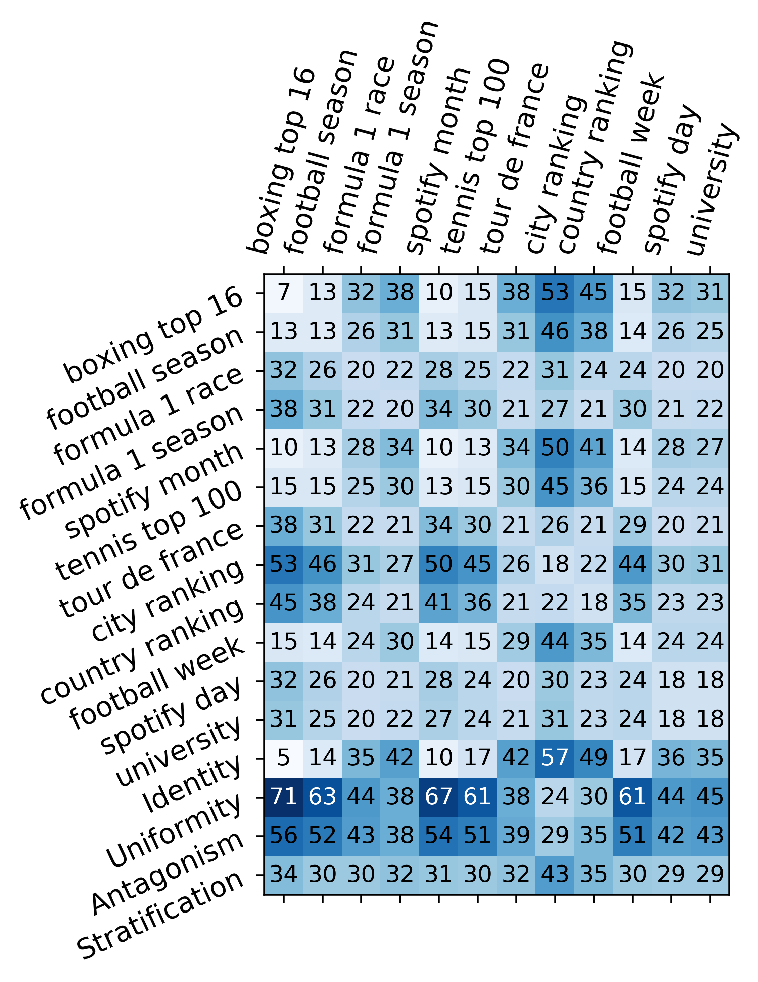
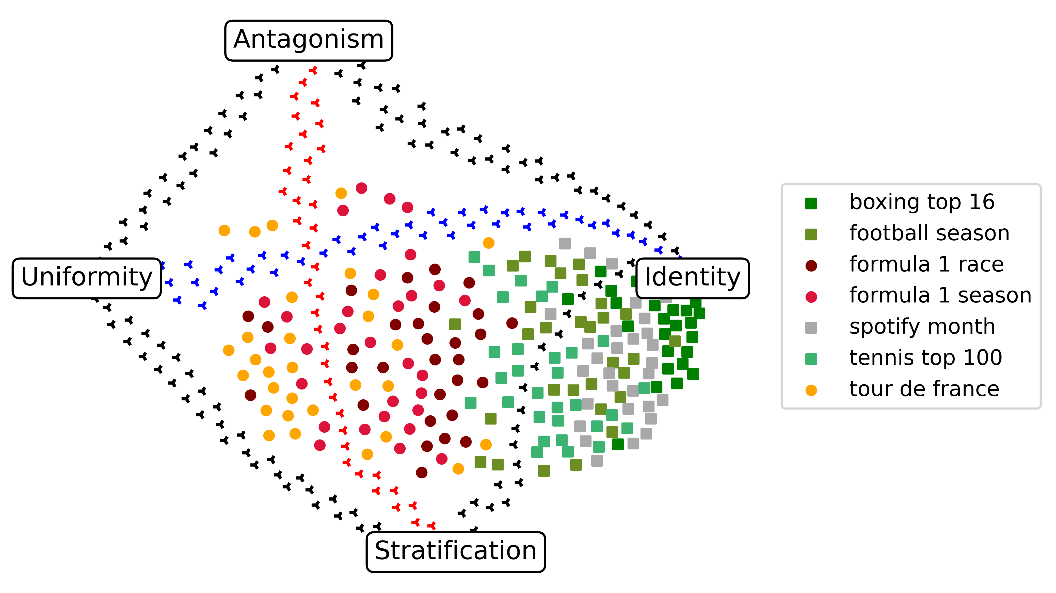
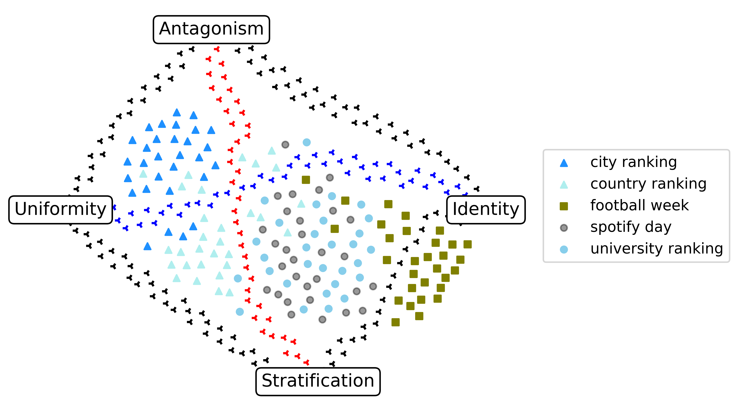
Map of Real-World Elections
Close to Identity elections (mostly time-based)
Elections from "the middle"
"Outliers" closer to Uniformity
→ very consistent behavior of data sources from one category
■
•
▲

Slide 72
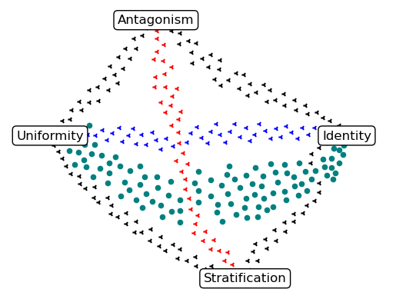
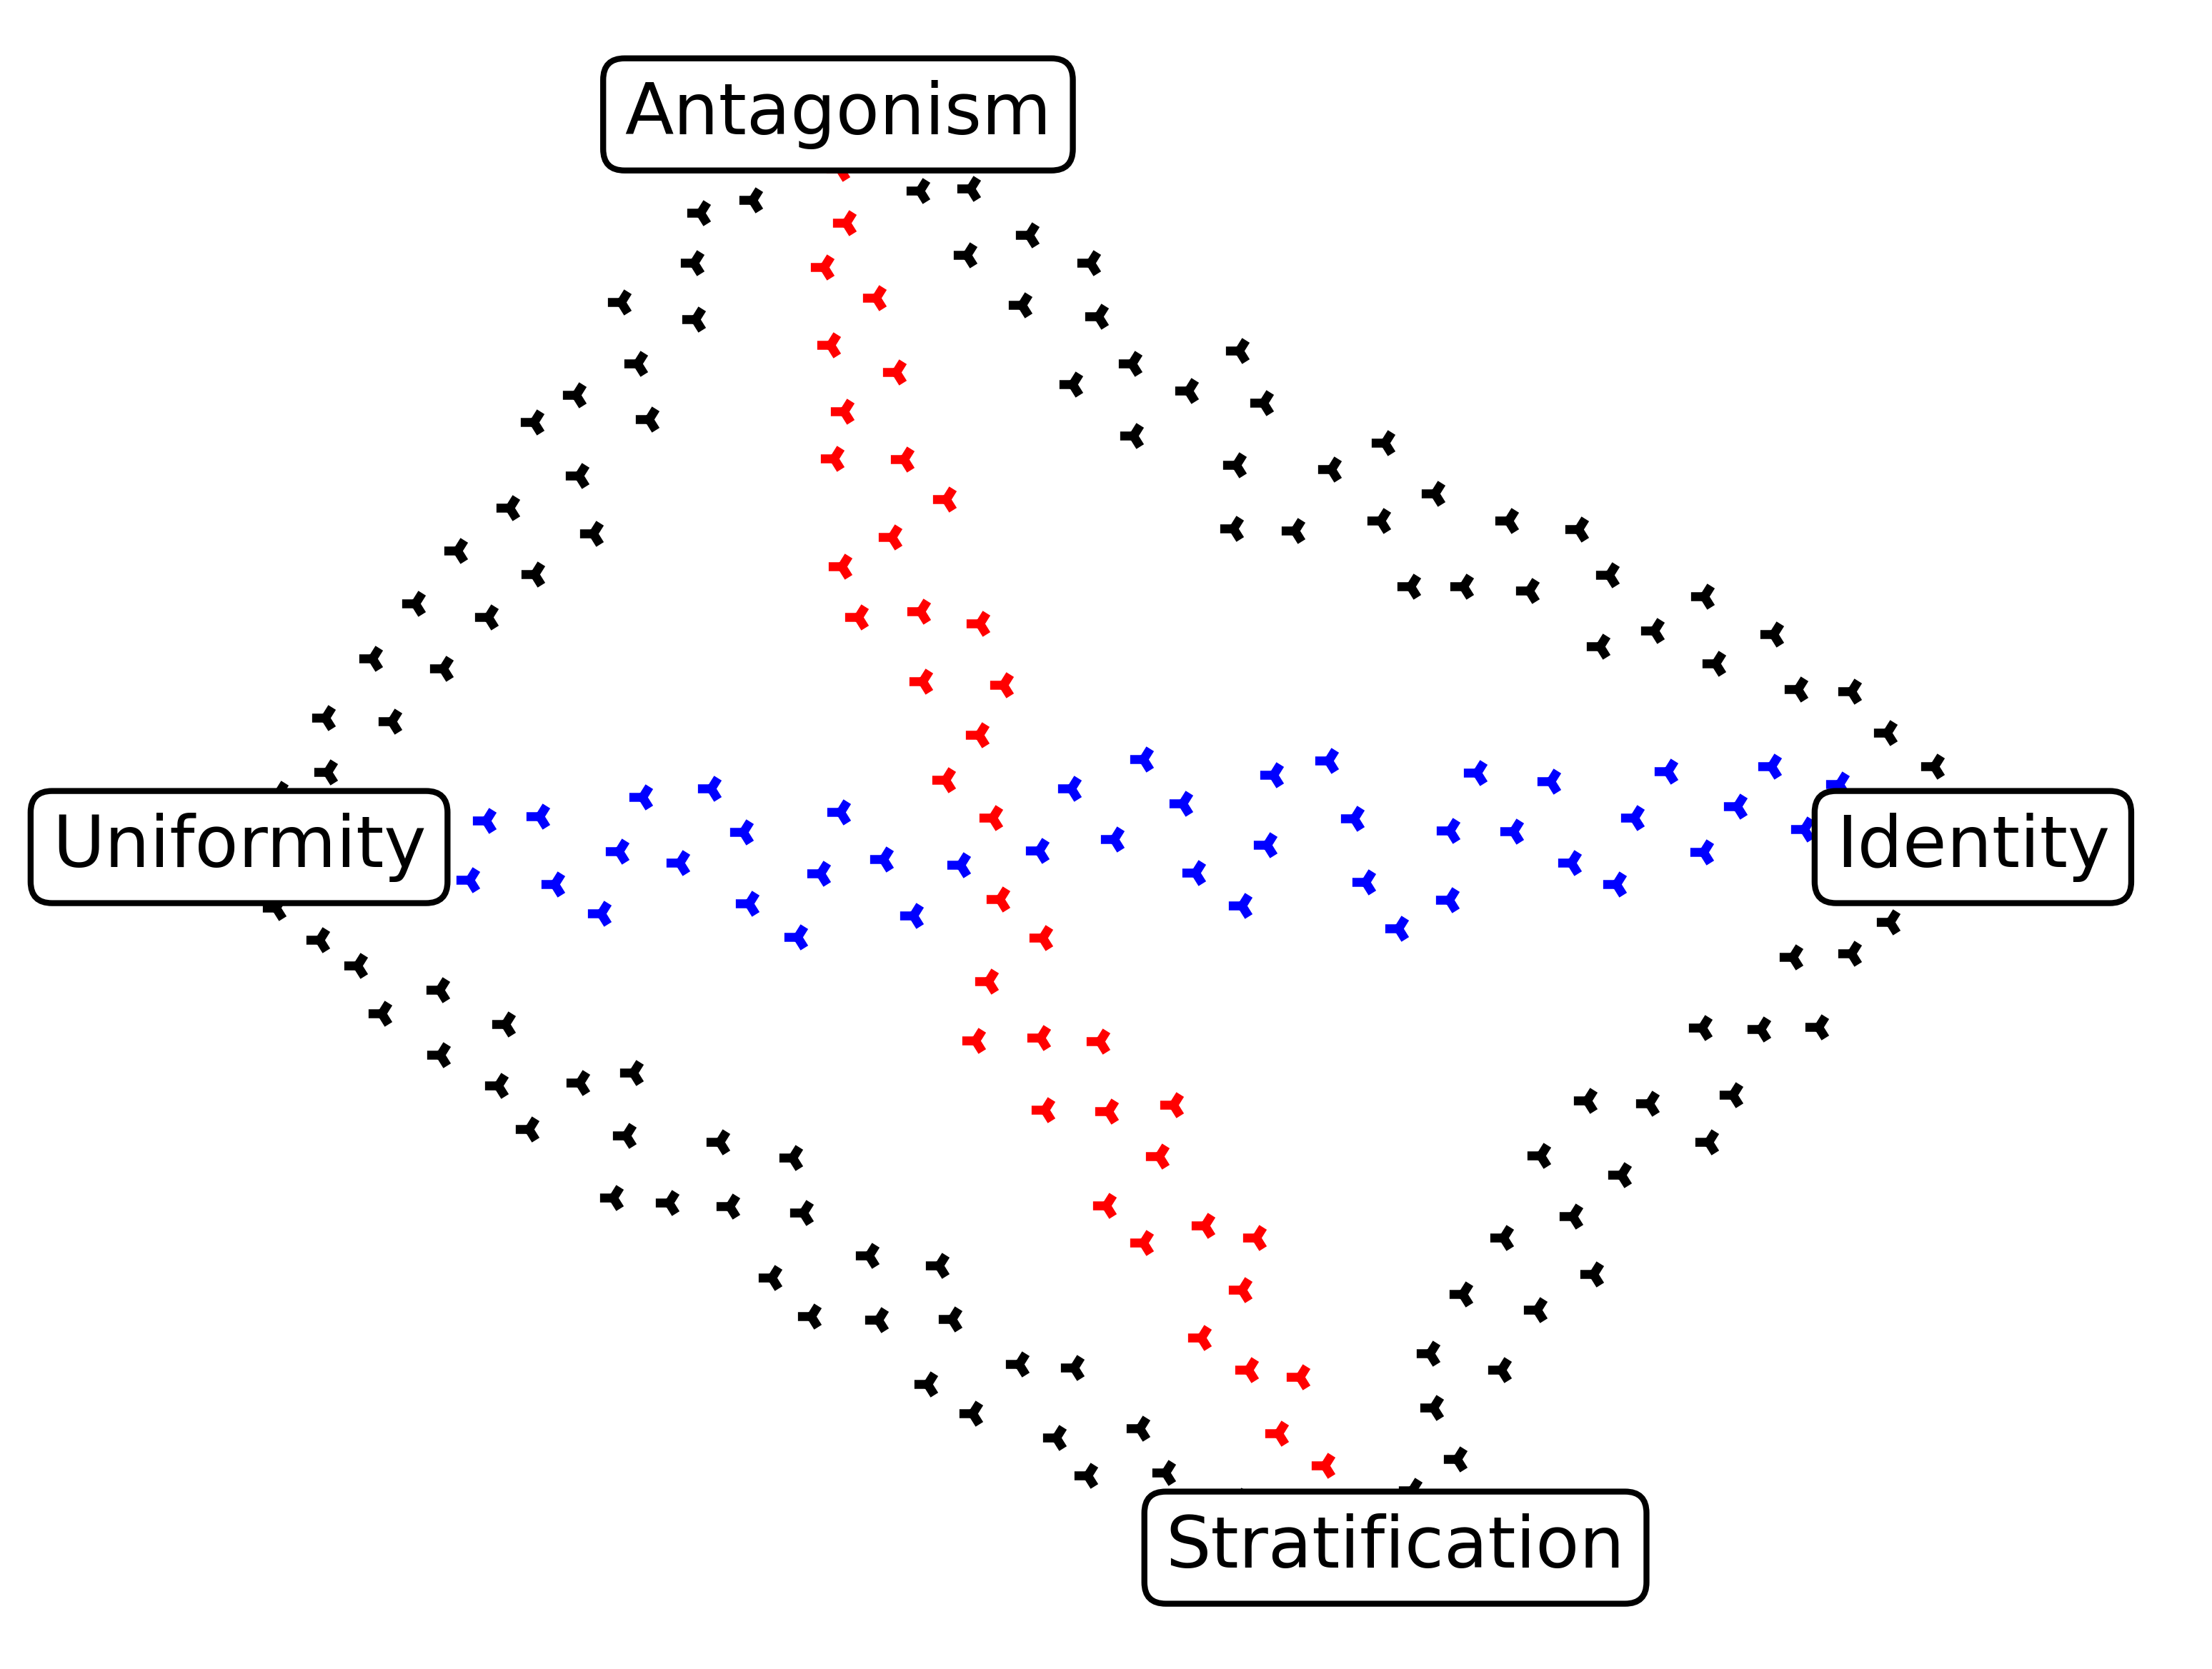
Different Types of Real-World Elections
indicator-based
ground-truth estimates
"political" elections
sport competitions
surveys

Slide 73

Conclusions
Map is a useful tool!
  Initial planning of experiments
  Running experiments
  Insight into statistical cultures
    … and real-life preferenca data
Many research issues
  What other metrics can be used?
  Any approach to using swap distance on large elections?
  Map of structured domains?
  Where are the holes in the maps?
  Maps of other types of objects?
Map of Elections

Slide 74
How Similar Are Two Elections?, P. Faliszewski, P. Skowron, A. Slinko, S. Szufa, N. Talmon, AAAI-2019.
Drawing a Map of Elections in the Space of Statistical Cultures, S. Szufa, P. Faliszewski, P. Skowron, A. Slinko, N. Talmon, AAMAS-2020.
Putting a Compass on the Map of Elections N. Boehmer, R. Bredereck, P. Faliszewski, R. Niedermeier, S. Szufa, IJCAI-2021.
The Complexity of Subelection Isomorphism Problems, P. Faliszewski, K. Sornat, S. Szufa, AAAI-2022
Understanding Distance Measures Among Elections, N. Boehmer, P. Faliszewski, R. Niedermeier, S. Szufa, T. Wąs, IJCAI-2022
How to Sample Approval Elections, S. Szufa, P. Faliszewski, L. Janeczko, M. Lackner, A. Slinko, K. Sornat, N. Talmon, IJCAI-2022.
Expected Frequency Matrices of Elections: Computation, Geometry, and Preference Learning, N. Boehmer, R. Bredereck, E. Elkind, P. Faliszewski, S. Szufa, NeurIPS-2022
Properties of Position Matrices and Their Elections, N. Boehmer, J.-Y. Cai, P. Faliszewski, A. Fan, Ł. Janeczko, A. Kaczmarczyk, T. Wąs, AAAI-2023
Diversity, Agreement, and Polarization in Elections, P. Faliszewski, A. Kaczmarczyk, K. Sornat, S. Szufa, T. Wąs, IJCAI-2023.

